Slide 1

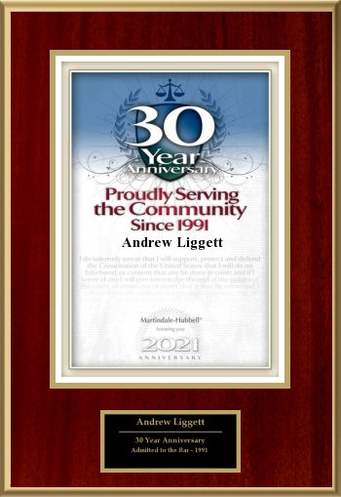



SOLVING DISPUTES
-with Lawyer Andrew Liggett

Slide 2
SOLVING DISPUTES
Struggling with PARENTING Disputes?
Discover practical solutions in our free webinar series.
Get free expert insights and resources at:
SeaToSkyLaw.CA

Slide 3
CAVEAT
INFO IS NOT ADVICE
Information is NOT legal advice.
You should NOT make tax nor investment decisions based on what you heard in the bar or read online so do not make decisions about your family law disputes based on just info.
Independent Legal Advice (ILA) is confidential advice from your own lawyer after they have learned all your relevant facts
NOTE – the advice from your partner’s lawyer is not ILA
You need your own lawyer to learn the consequences of your choices

Slide 4
Solving PARENTING Disputes
– What are My Choices
You will learn three methods to solve your disputes
1. Counselling
2. ADR
3. Different BC Courts

Slide 5
1. COUNSELLING = E.A.R
a) Establish a process to achieve agreement
b) Avoid legal problems
c) Reduce Stress

Slide 6
COUNSELLING = E.A.R a) Establish a process to achieve agreement
1 Save money by reducing emotions
2 Know path forward by working backwards
3 Confirm facts before feelings
4 Foundation of Agreement is Facts
5 Be Heard by Listening First

Slide 7
COUNSELING = E.A.R b) Avoid legal problems
1 Legal priority is child safety
2 BC Family Violence Definition Open
3 Avoid escalation of consequences
4 Be proactive in counseling
5 Less conflict Happy Children

Slide 8
COUNSELING = E.A.R c) Reduce Stress
1 Conflict from Stress Kills
2 Emotions prevent objectivity
3 Think long term = family is forever
4 Be Calm and Carry On
5 Knowledge is Power = Be Coachable

Slide 9
2. Alternative Dispute Resolution (ADR)
a) Aunt Philly
b) Formal Mediation & Collaborative Discussions
c) Arbitration – private decision maker

Slide 10
2. Alternative Dispute Resolution (ADR) a) Aunt Philly
1 FLA encourages ADR anytime
2 Informal mediation is just talk
3 Keep it simple and polite
4 Never sign anything without prior ILA
5 Remember Confidentiality

Slide 11
2. Alternative Dispute Resolution (ADR) b) Formal Mediation & Collaborative Discussions
1 Negotiation, Mediation and Collaboration
2 Professional and Confidential Mediation
3 Parties decide not mediator
4 Official collaboration process excludes court
5 Still need ILA

Slide 12
2. Alternative Dispute Resolution (ADR) c) Arbitration – private decision maker
1 ADR includes private arbitration
2 Private Confidential Judge
3 PRO - parties decide process
4 PRO – no dirty laundry
5 CON – could be expensive

Slide 13
3. DIFFERENT BC COURTS
a) Online Tribunals
b) User-friendly but limited issue Provincial Family Court
c) All issues but More Formal Supreme Court

Slide 14
3. DIFFERENT BC COURTS a) Tribunals for related family law issue(s)
1 Civil Resolution Tribunal (“CRT”) BC unique
2 Additional online tribunal inexpensive & convenient
3 Specified Jurisdiction for Decision Types
4 Family disputes can include Revenge Porn
5 Decisions Enforceable by Courts

Slide 15
3. DIFFERENT BC COURTS b) User-friendly but limited Provincial Family Court
1 User-friendly design for all child and safety issues
2 Alimony but not divorce nor asset division
3 People not paper focus
4 Free Justice Counselors
5 Ignorance no excuse = Need ILA

Slide 16
3. DIFFERENT BC COURTS c) All issues but More Formal Supreme Court
1 Traditional with full equitable authority
2 Jurisdiction to decide all family law issues and more
3 Paper not People focus
4 Discovery and all technical legal arguments
5 Longer time and higher costs

Slide 17
KEY TAKEAWAYS
1 Facts Before Feelings = Emotions Cost Money
2 Proactive Counselling = Avoid Consequences
3 Knowledge is Power = get ILA often
4 Be Patient = Think Long Term
5 DIY = fool for a lawyer

Slide 18
NEXT WEBINAR
DATE

Slide 19
JOIN OUR SOCIALS: CCMF
Facebook Page:
https://www.facebook.com/menandfamilies
CCMF Programs:
https://menandfamilies.org/ccmfbc/

Slide 20
JOIN OUR SOCIALS: SeaToSkyLaw
For 24/7 HELP talk to our A I assistant by phone, text and Email = (236) 239-1581 seatoskylawcanhelp@thevirtualgurus.ai
Facebook : https://www.facebook.com/seatoskylaw.ca/
YouTube: https://www.youtube.com/@seatoskylaw9252
Website: SeaToSkyLaw.CA

Slide 21
Q and A
It’s Your Turn!
Feel free to ask questions and get answers

