Slide 1

Plan Design
Prepared for: John and Mary Sample
Prepared by: Neil R. Covert, Attorney at Law

Slide 2
Disclaimer
This Plan Design was prepared based upon an illustration produced with software by a mechanized system that is intended to illustrate and explain an estate plan or related concept.
This presentation should not be relied upon for accuracy, strategy selection or guidance, and should be carefully reviewed by an appropriate professional before making any decision regarding to your financial or tax situation or estate plan.
Potential distortion can occur, with respect to intended and actual results, due to the use of computerized models and human error in the use of software or programming there of, and the resulting illustrations. Neil R. Covert and Neil R. Covert, P.A. specifically disclaim any liability or obligation for any inaccuracy or deviation between what is illustrated, what the tax law may be, and the expected or actual results.

Slide 3
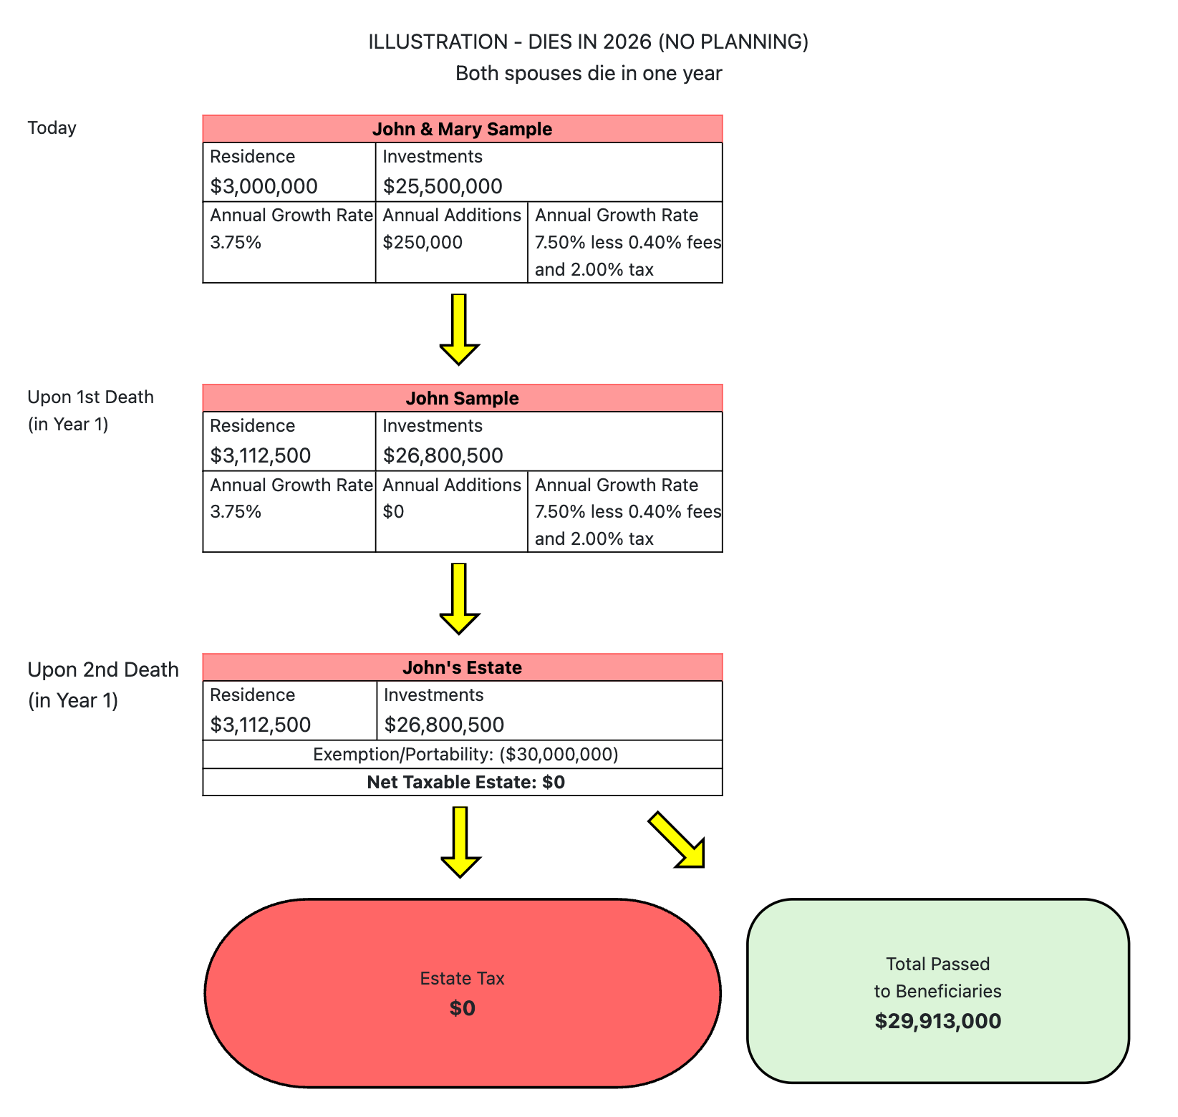

Slide 4
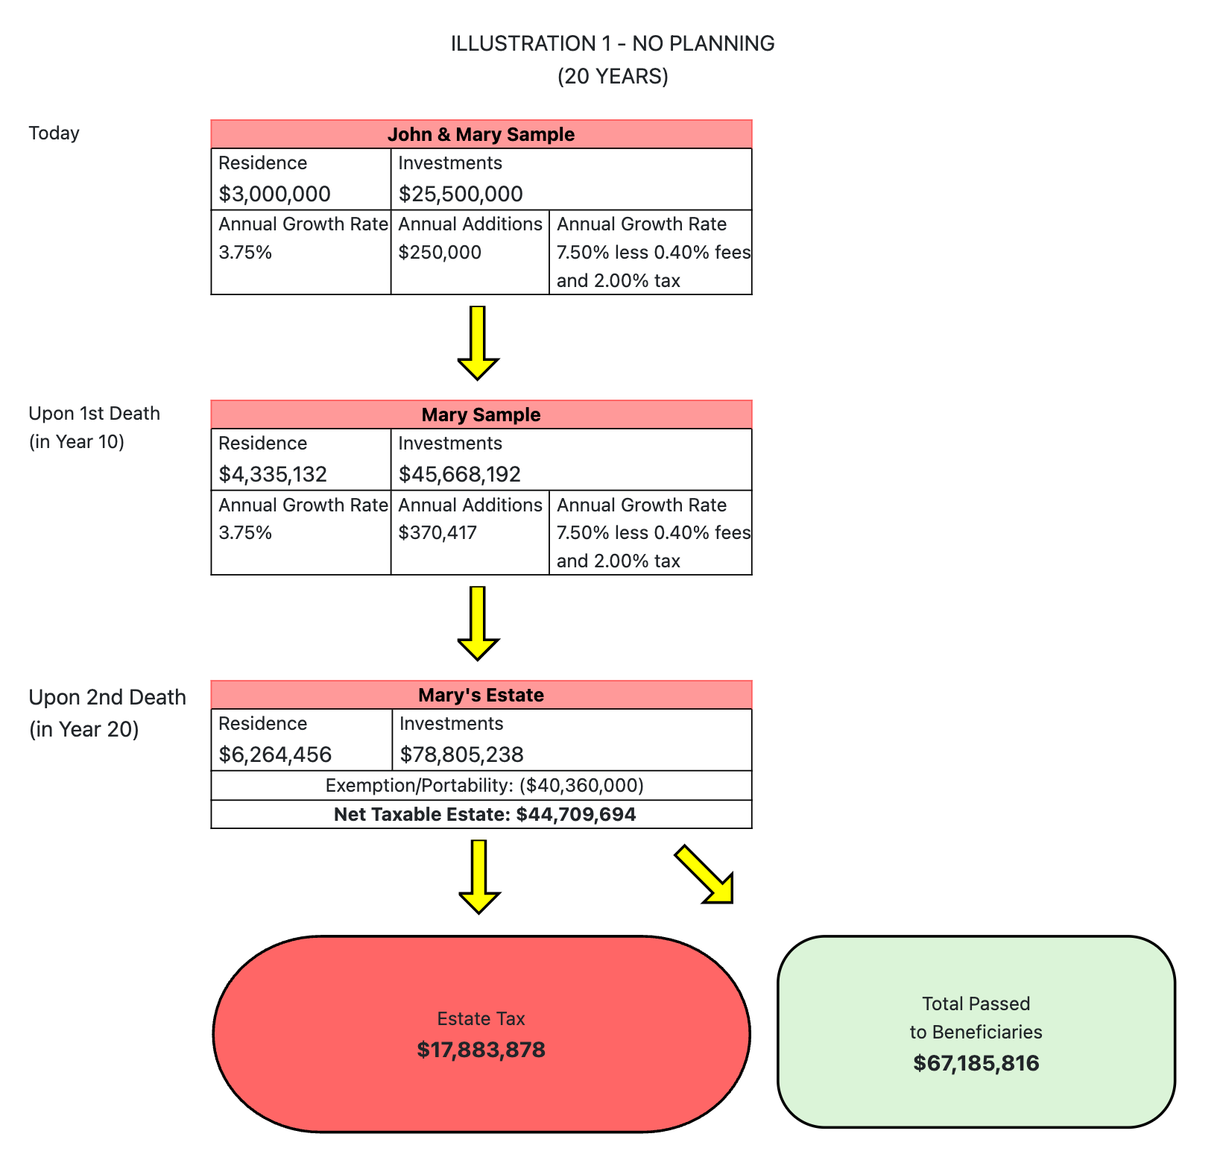

Slide 5
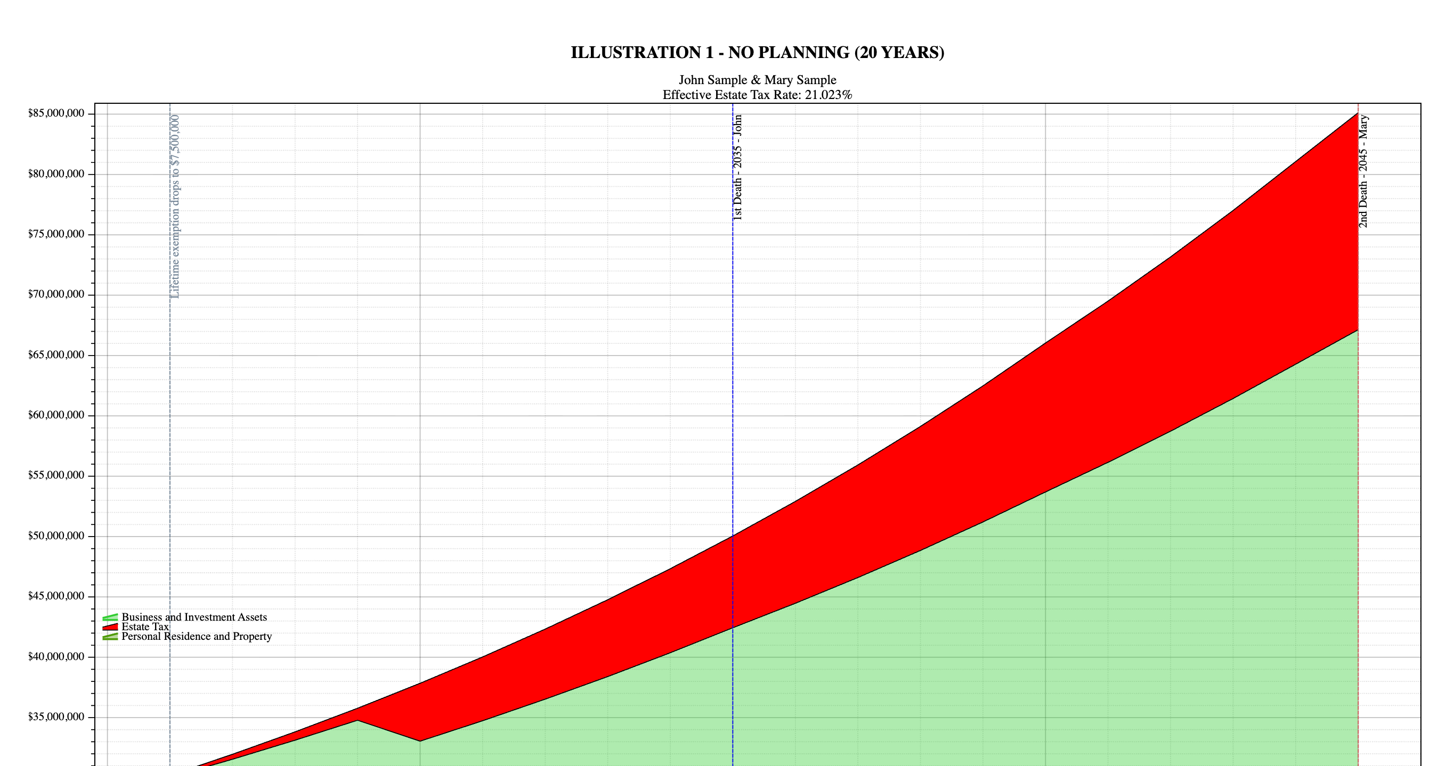

Slide 6
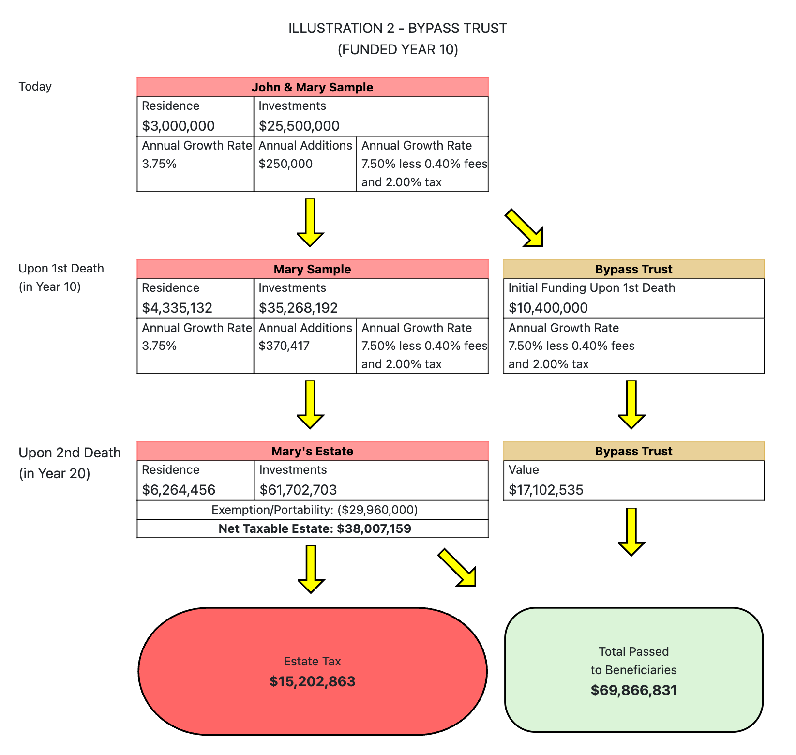

Slide 7
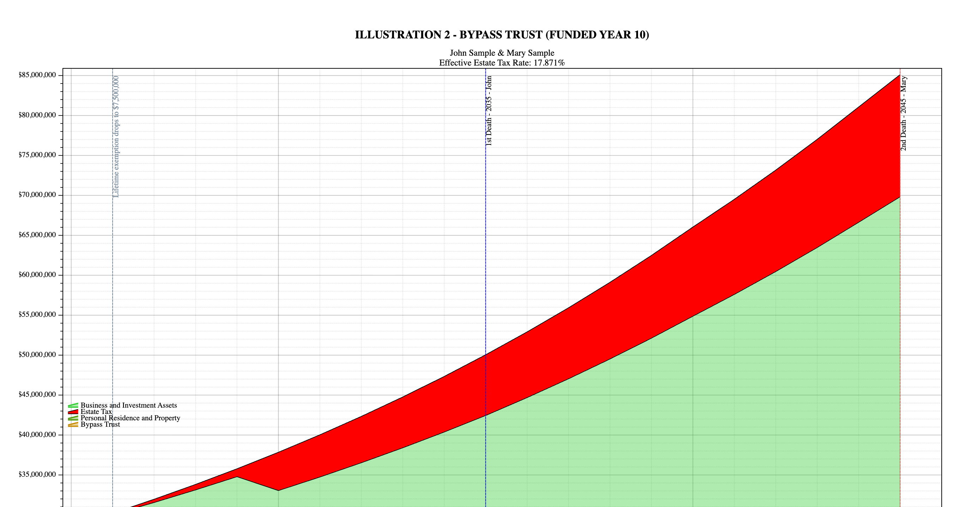

Slide 8
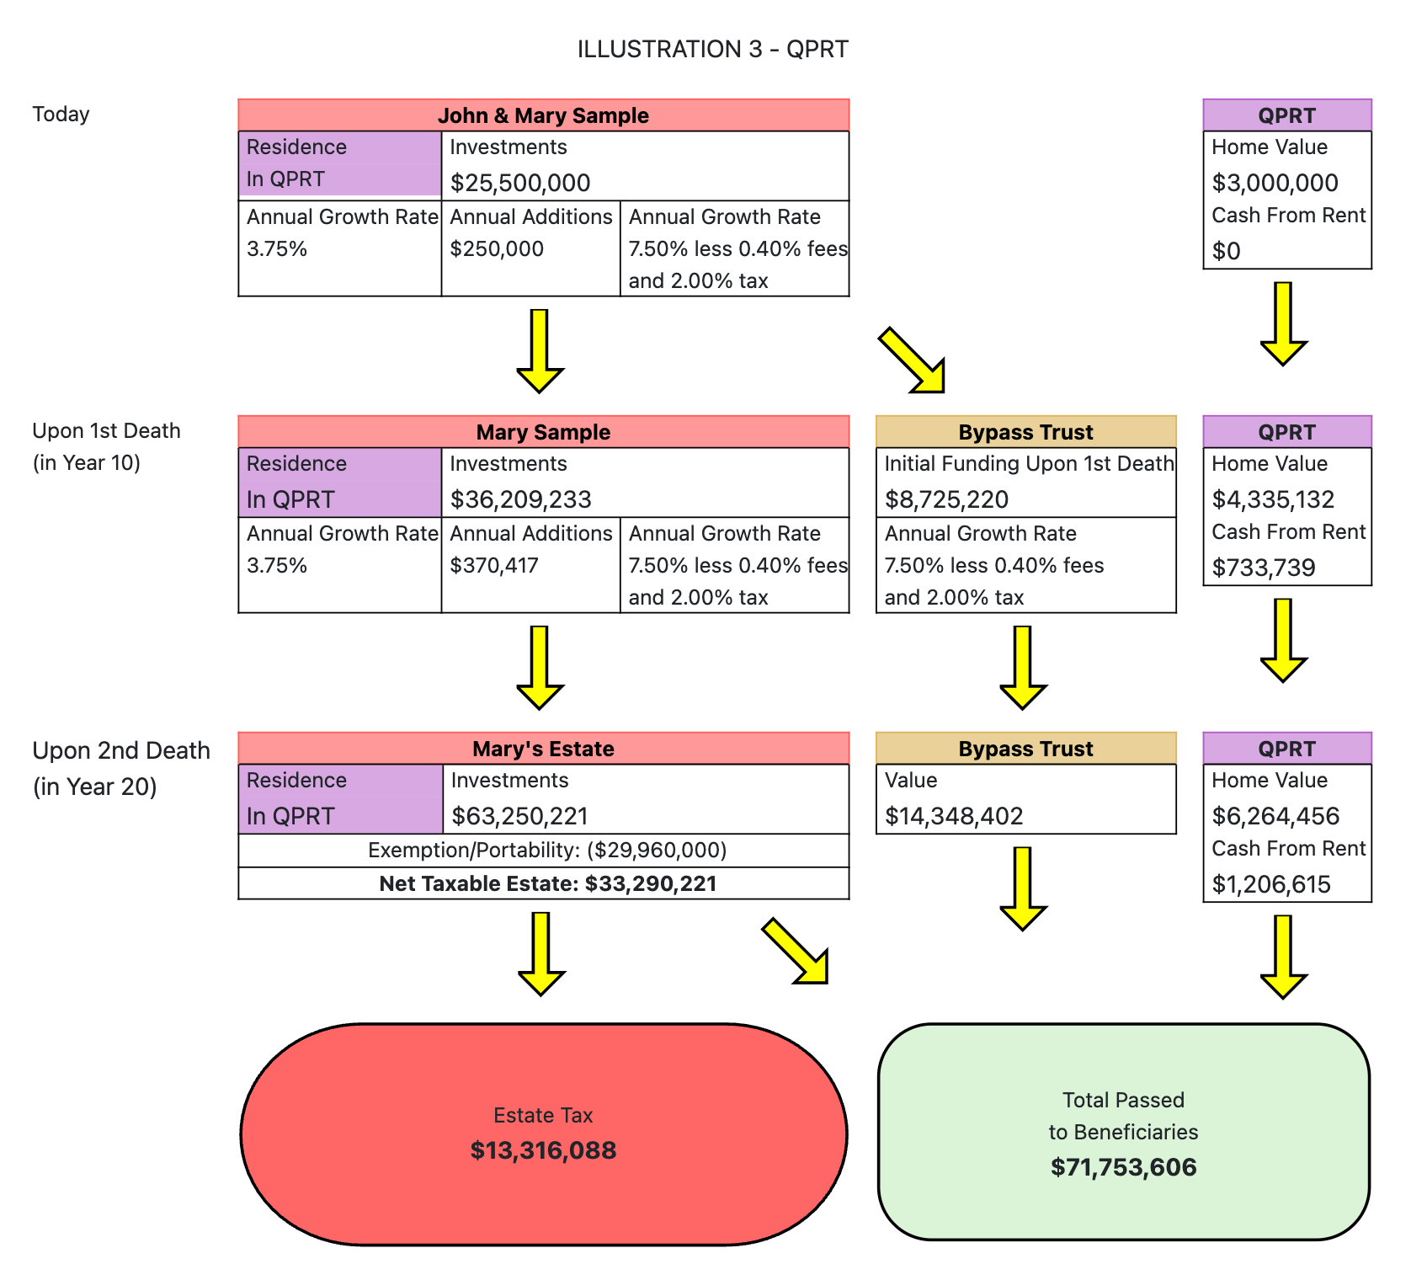

Slide 9
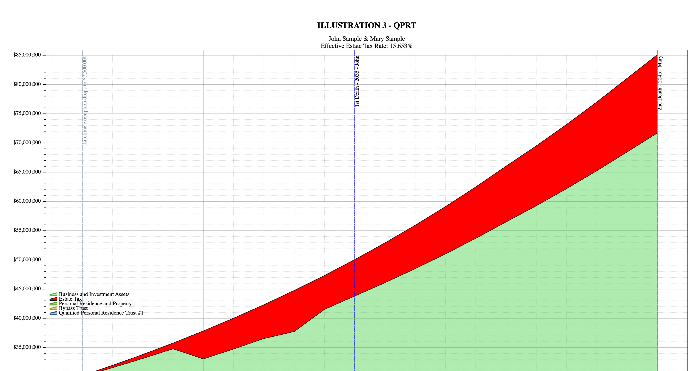

Slide 10
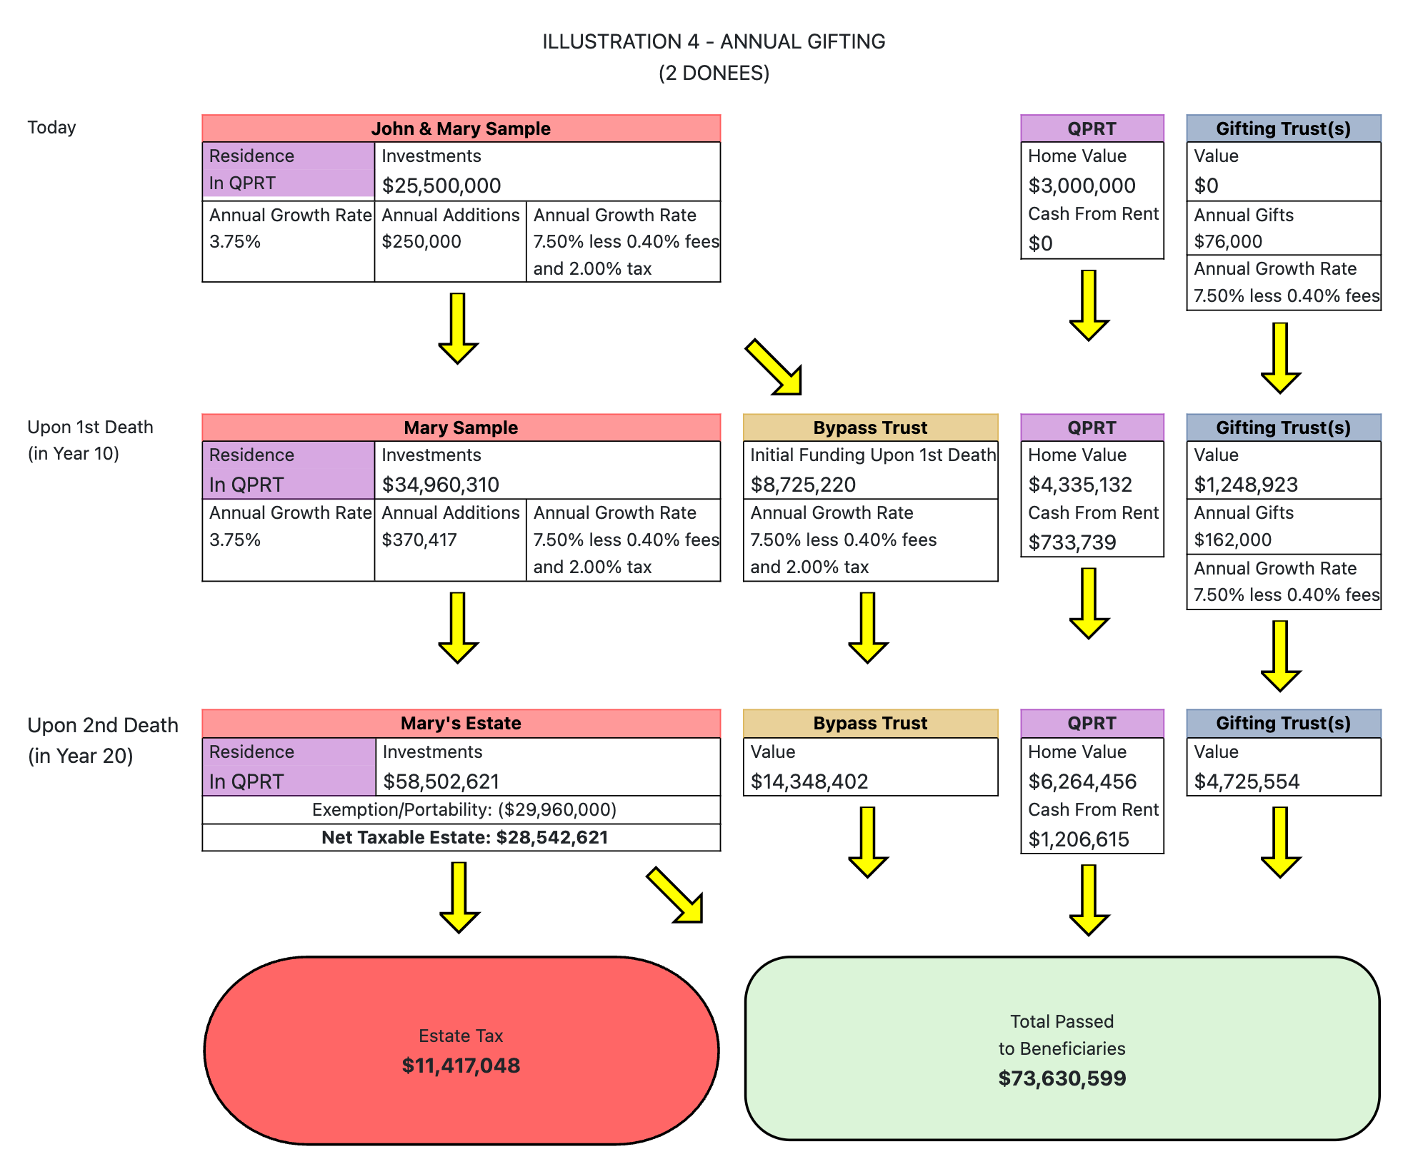

Slide 11
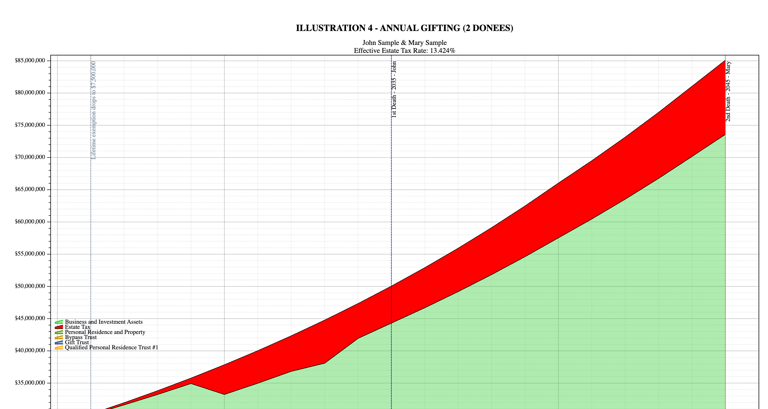

Slide 12
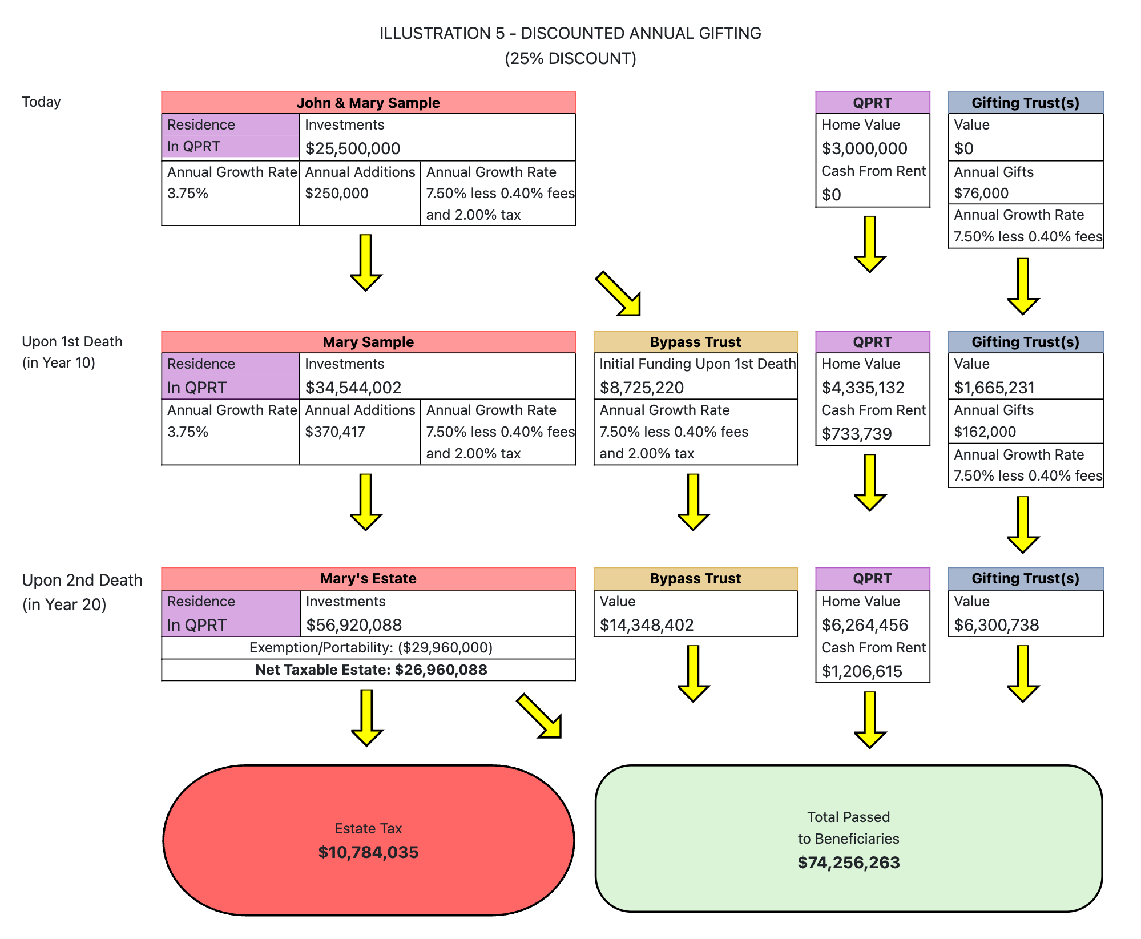

Slide 13
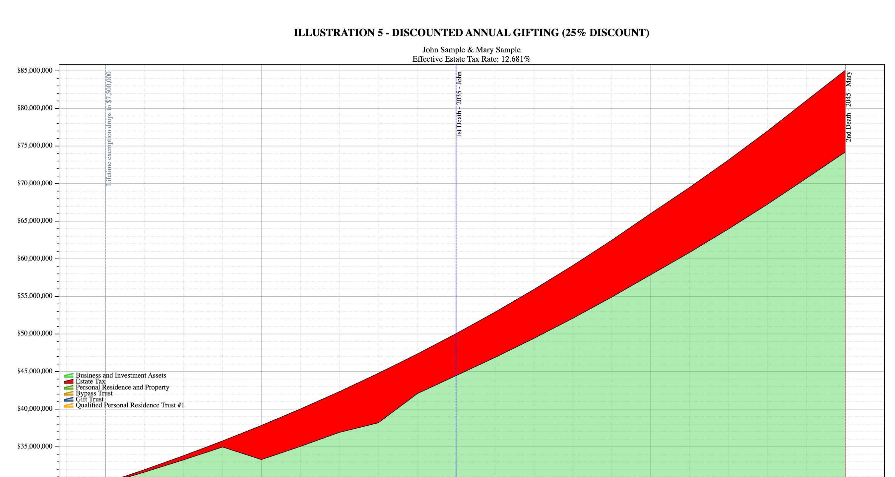

Slide 14
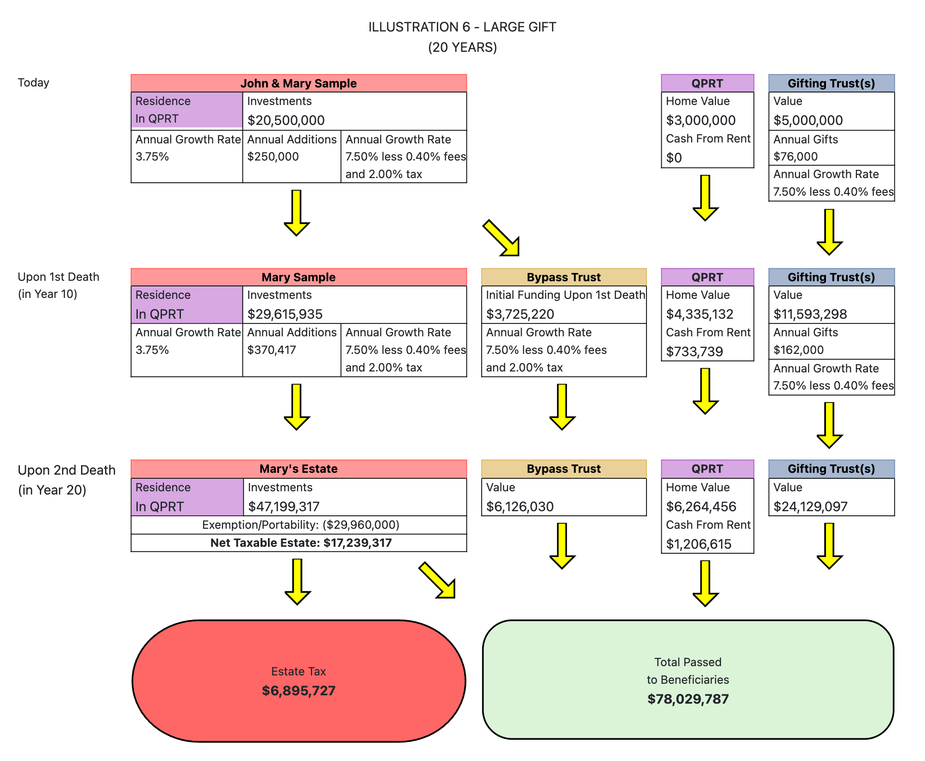

Slide 15
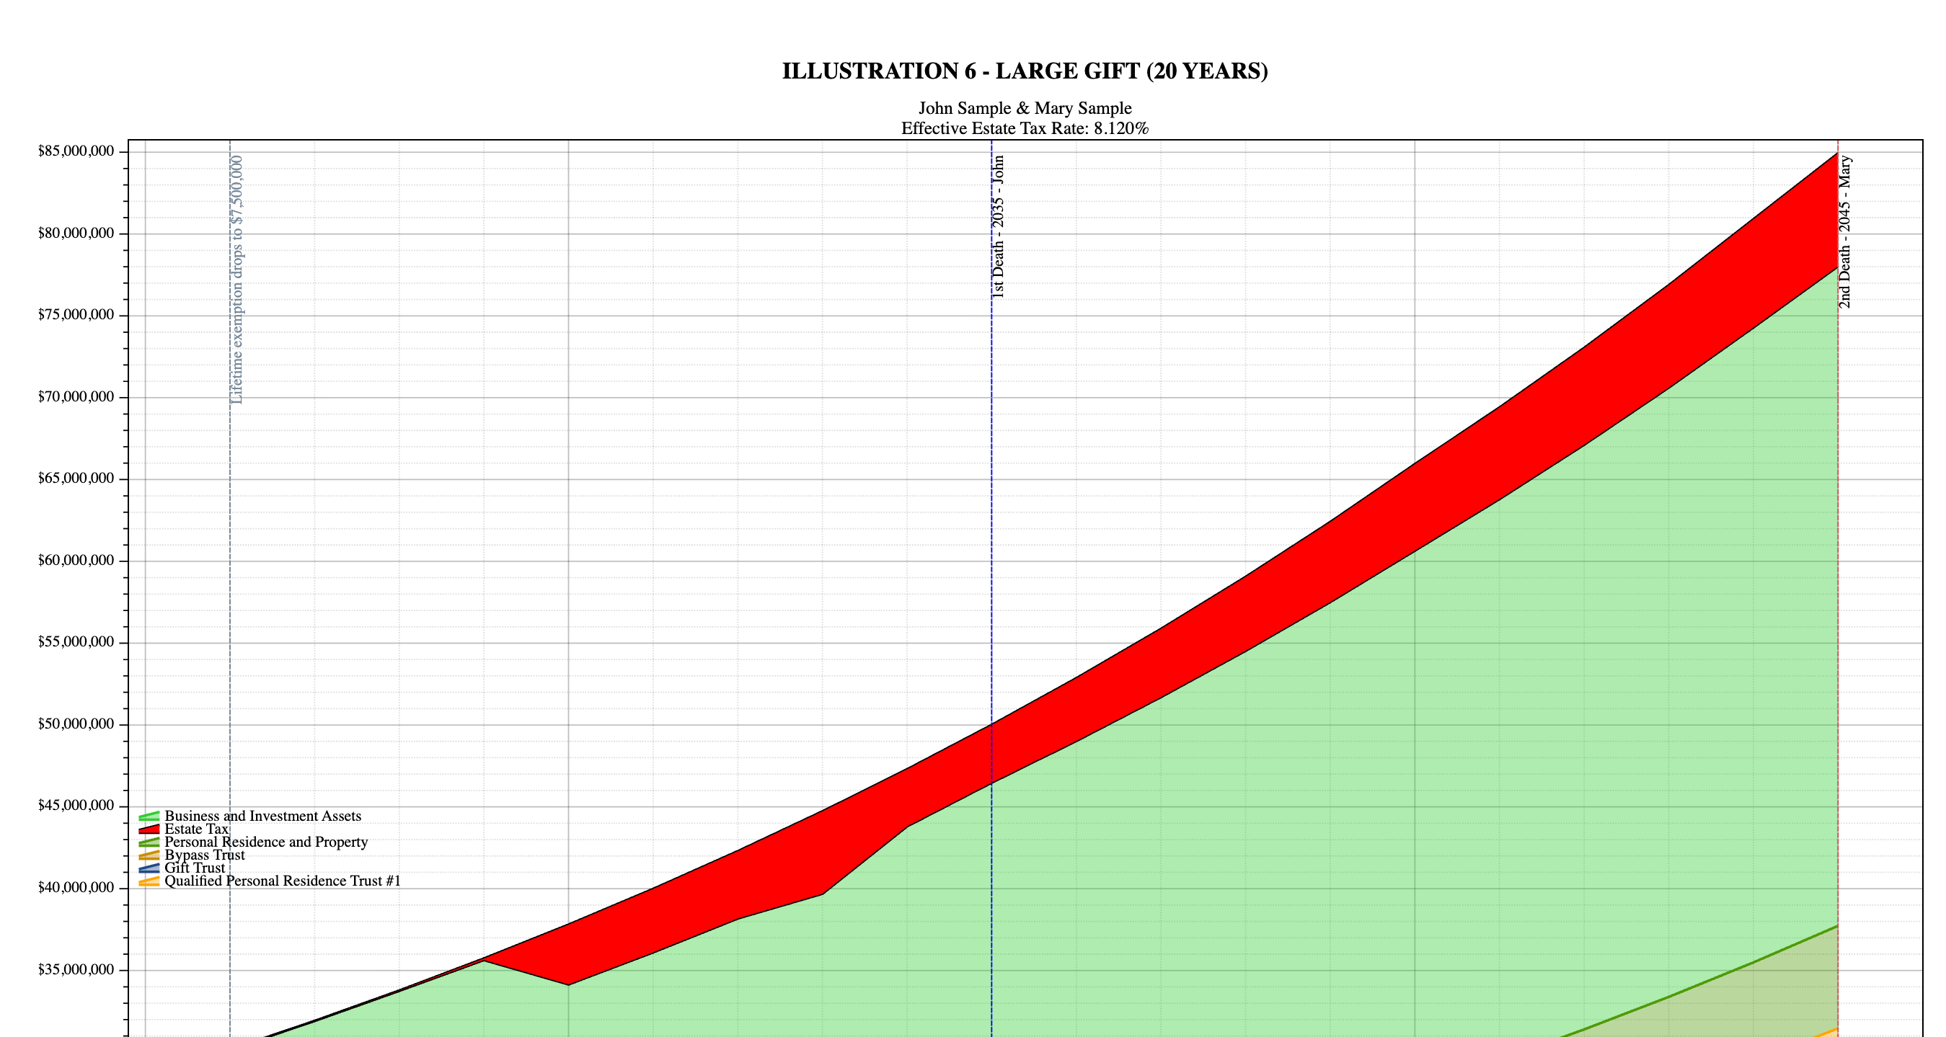

Slide 16
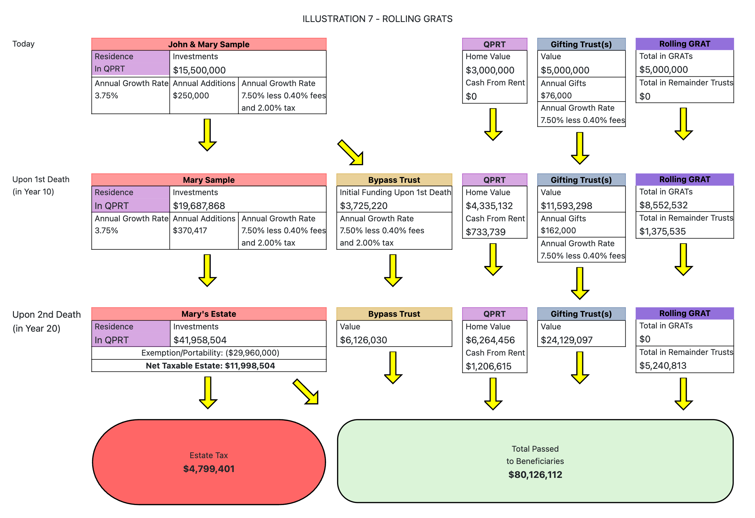

Slide 17
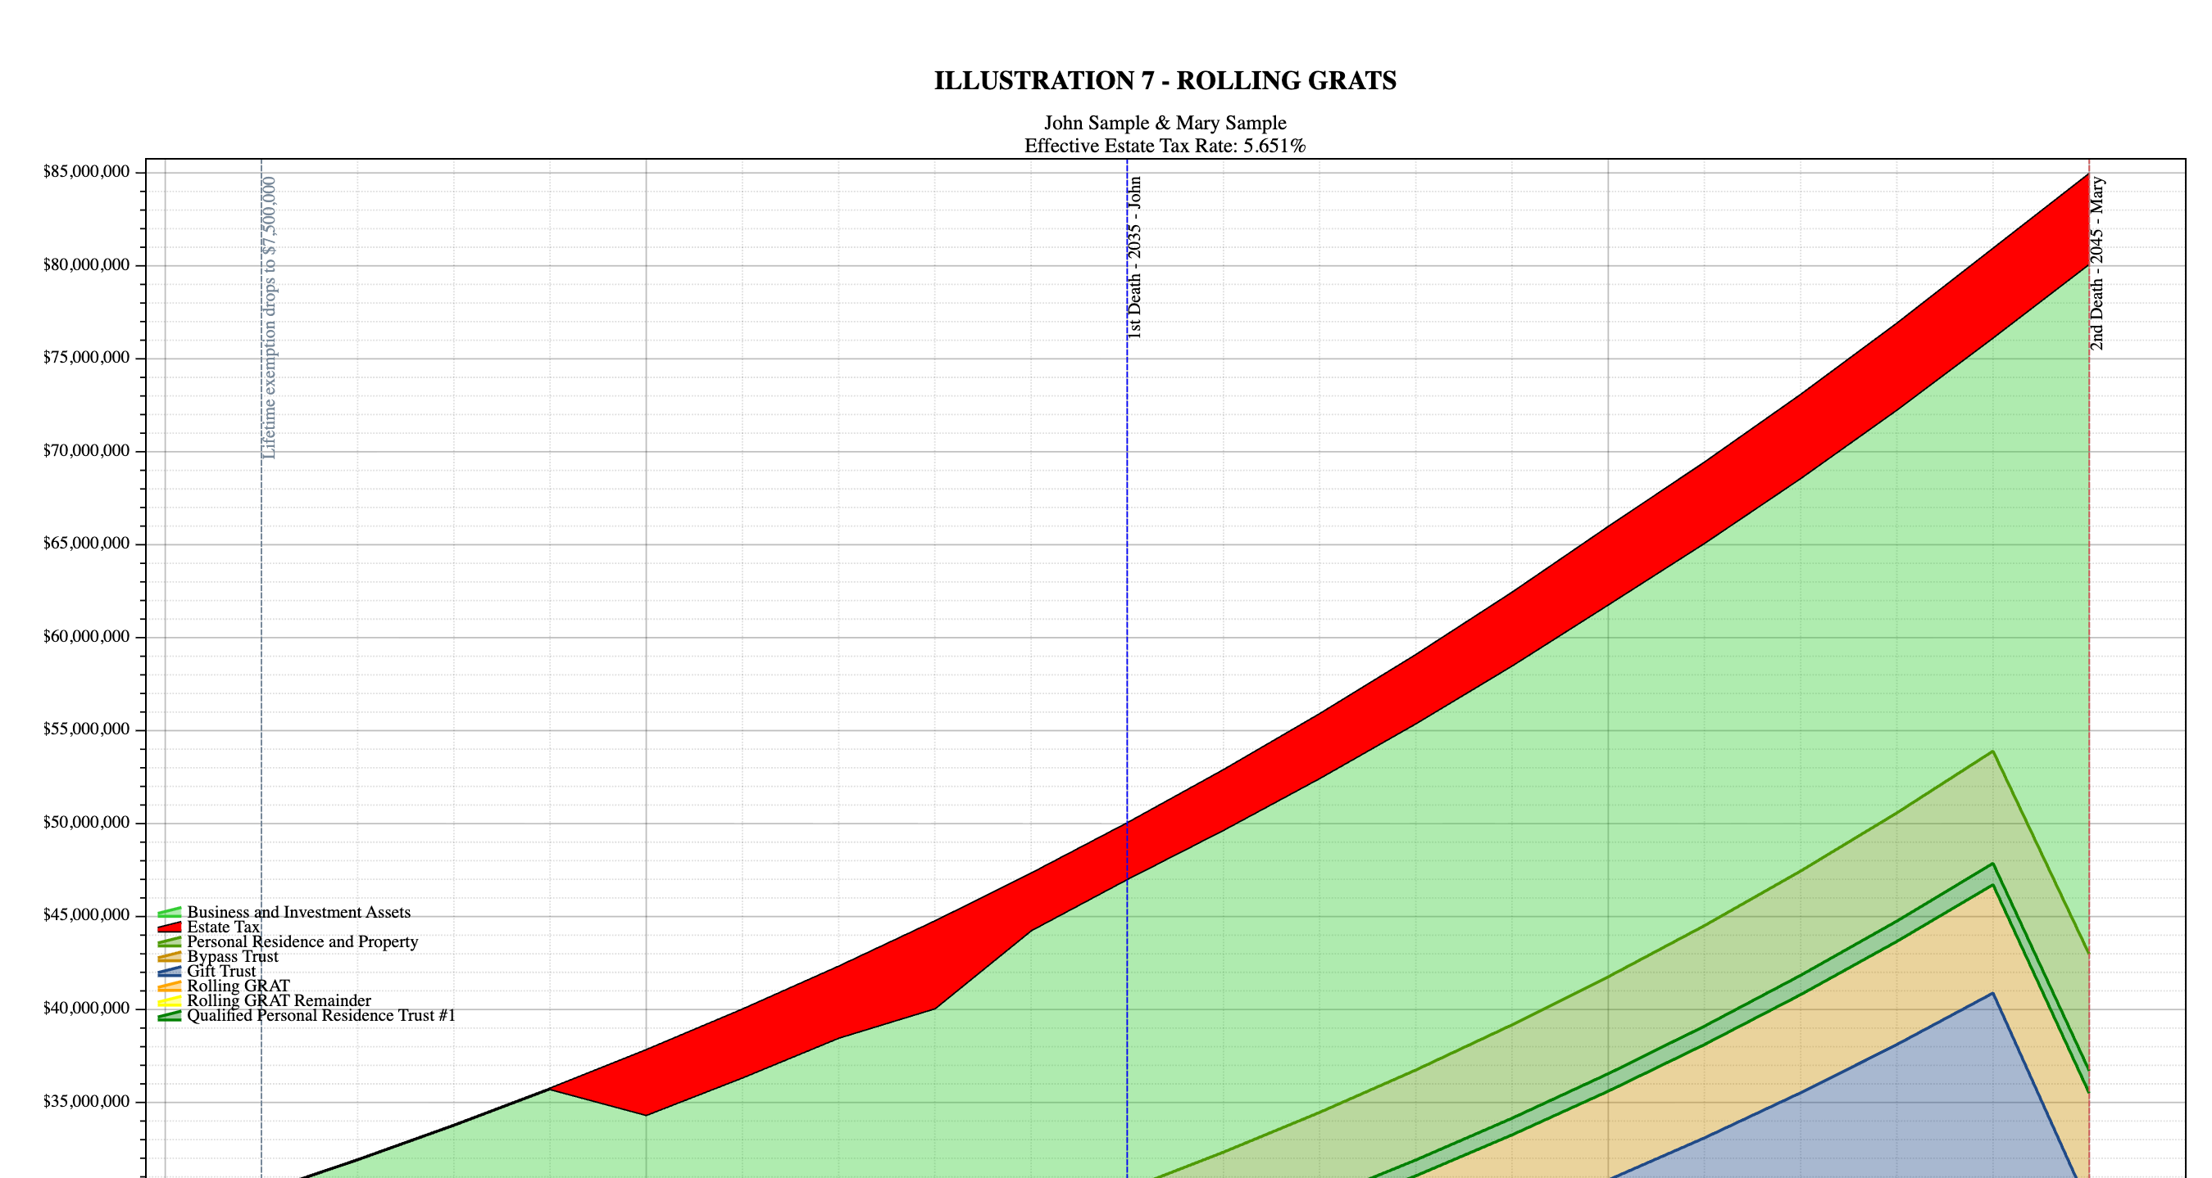

Slide 18
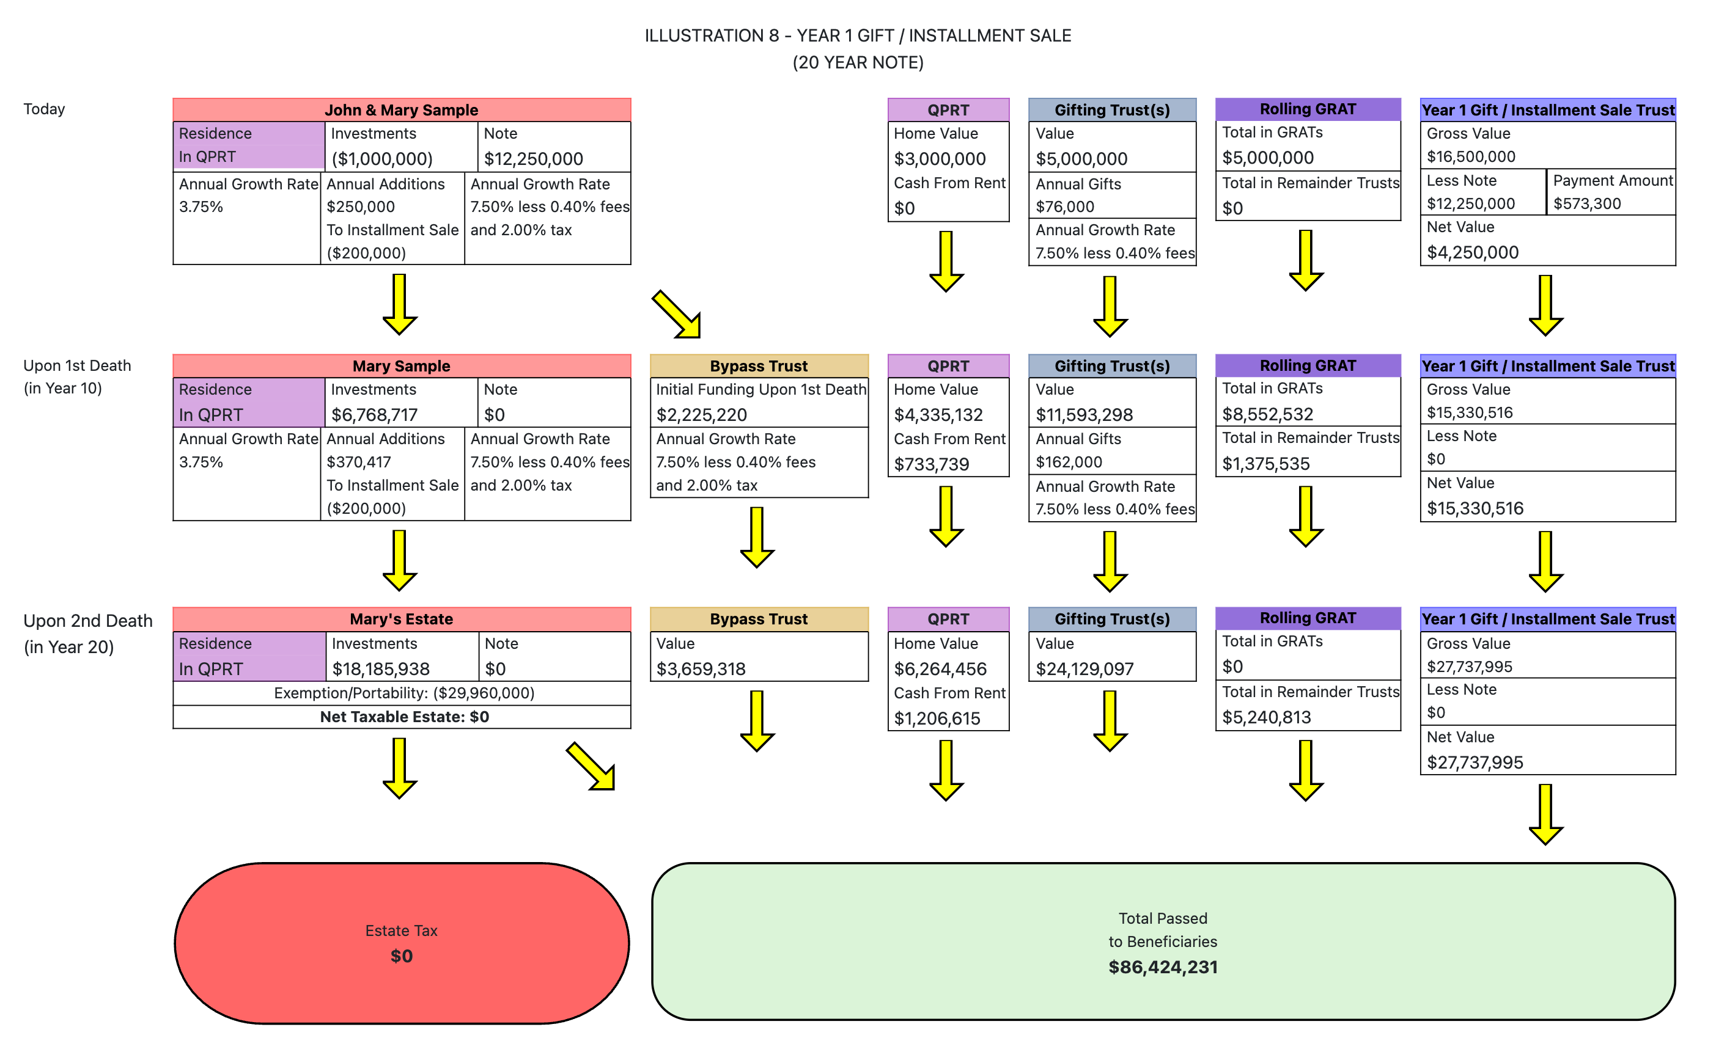

Slide 19
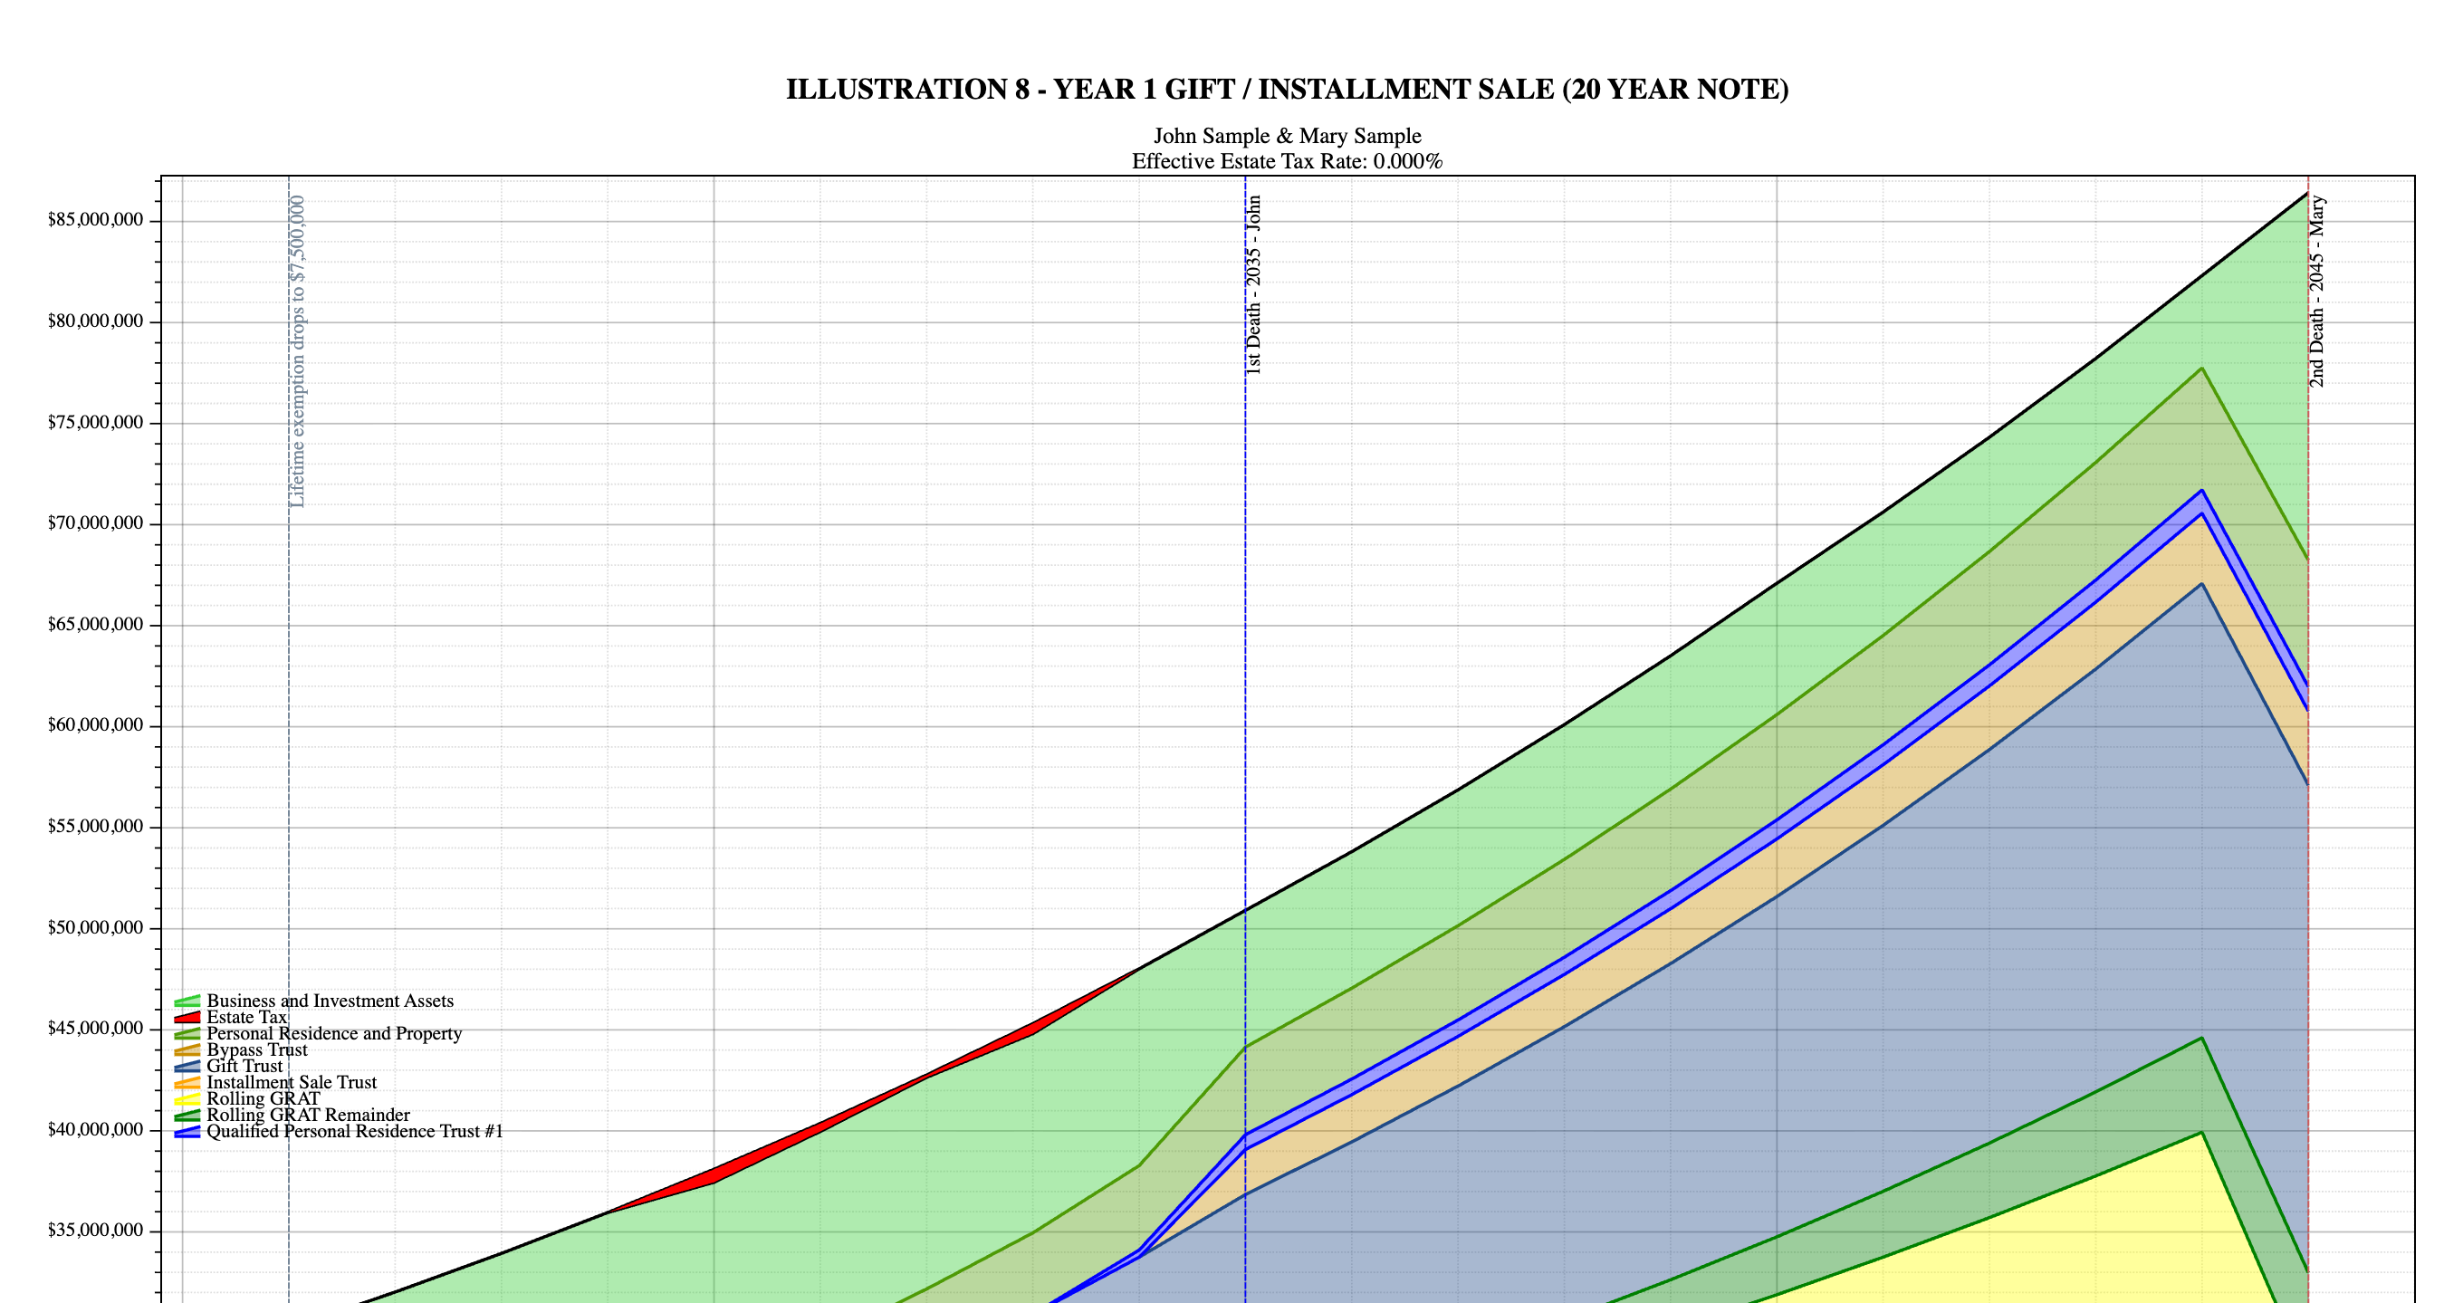

Slide 20
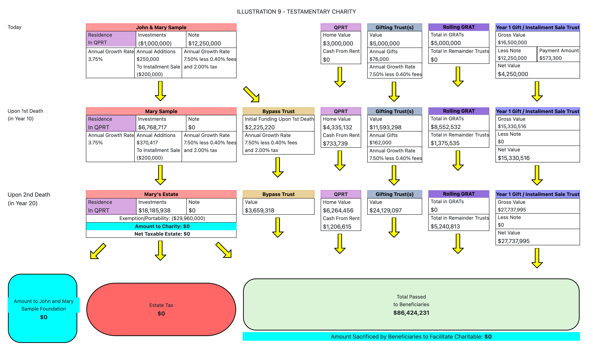

Slide 21


