Slide 1

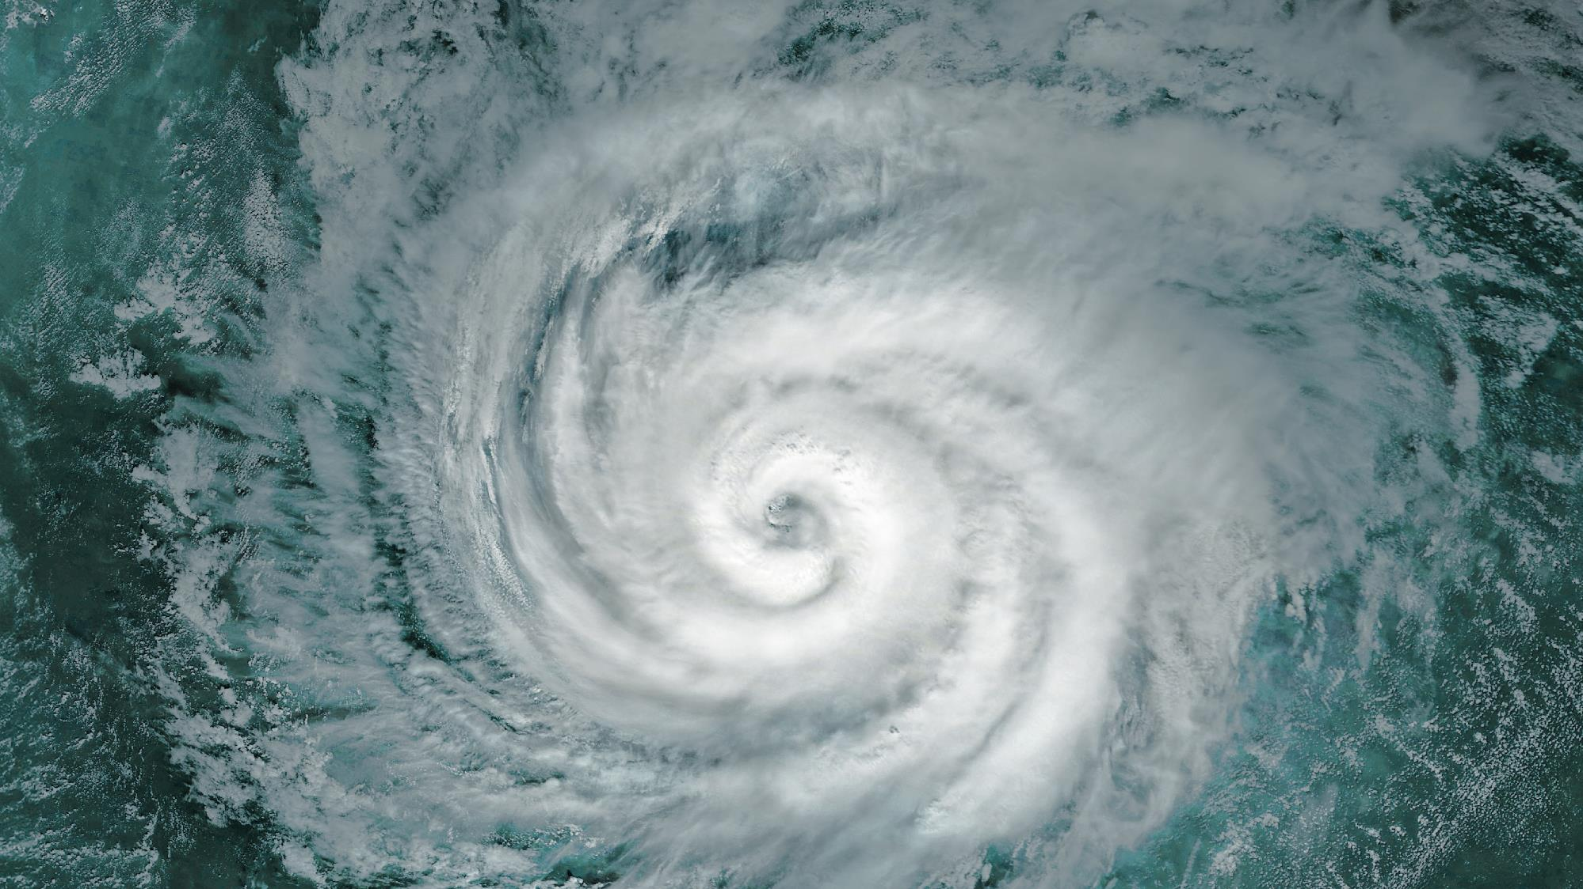

FLORIDA CASE LAW UPDATE
Notes:
Alt+F5 launches the slideshow in Presenter view with your speaker notes.
CTRL+Click and drag with your mouse to turn your cursor into a red laser in slideshow mode.

Slide 2


Conference Policies
Audio or video recording of any workshop is strictly prohibited.
Attendees need to attend the workshop in entirety to receive CE.

Slide 3
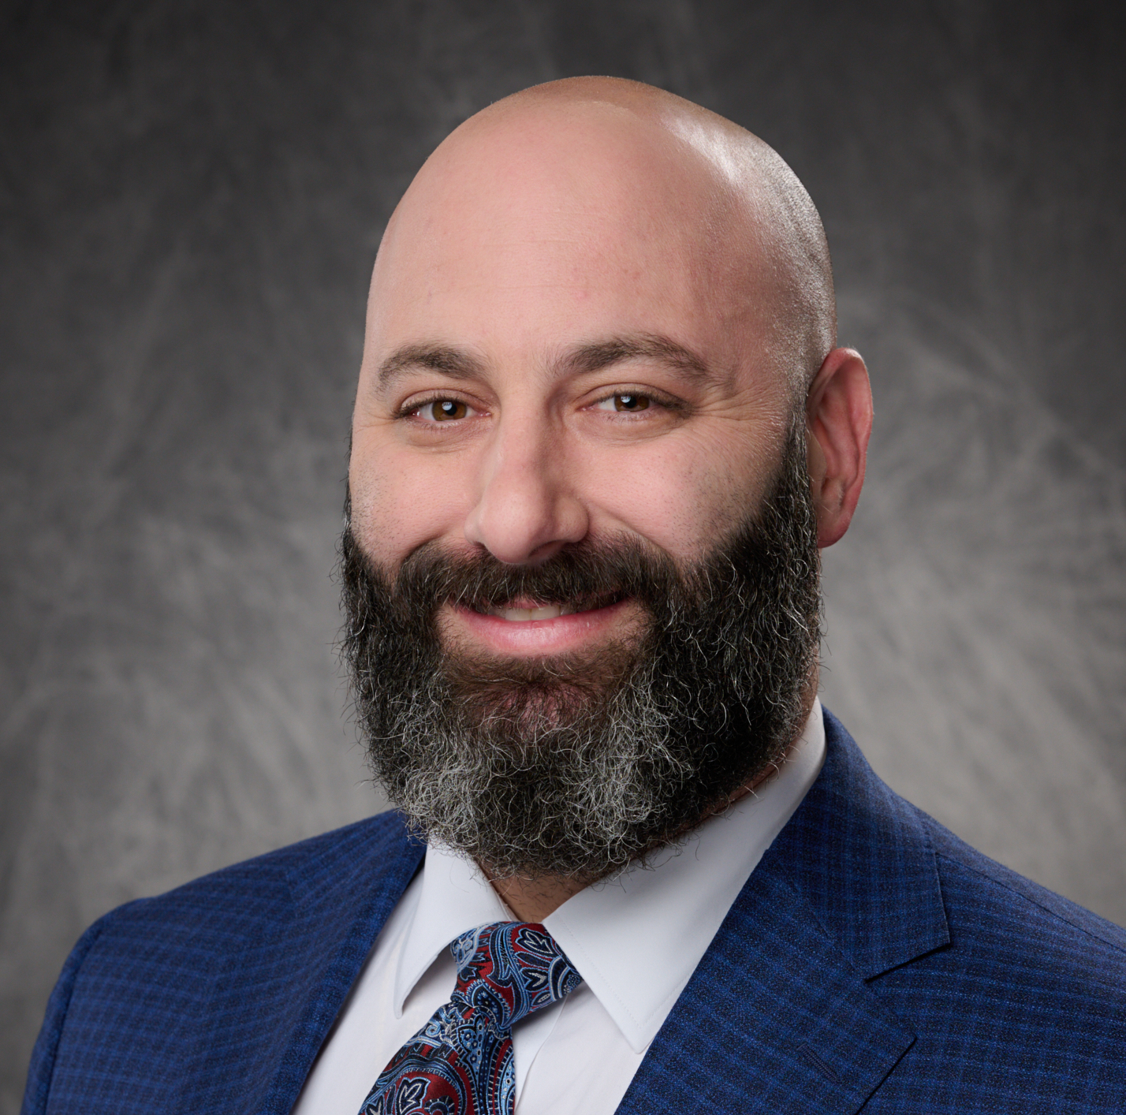
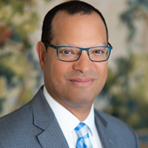
Michael A. Cassel, Esq., LL.M.
Paulo R. Lima, Esq.
Cassel & Cassel, P.A.
Managing Partner
Russo Lima Appellate Firm, P.A.
Partner

Slide 4
LOSS SETTLEMENT

Slide 5
Blanch v. Universal Prop. & Cas. Ins. Co.
405 So. 3d 495 (Fla. 3d DCA 2025)
FACTS:
After Insurer paid ACV of insureds’ plumbing claim, insureds submitted RCV estimate and filed suit. Trial court granted insurer’s MSJ, finding insureds were not yet entitled to RCV because they had not yet made repairs. Insureds appealed, then filed separate suit, alleging they had now made repairs which entitled them to recover RCV.
HOLDING:
Third District granted Universal’s motion to dismiss the appeal as moot. “[T]his appeal, which has to do with Universal’s alleged breach for failure to pay ACV, is moot….Because the Homeowners allege [in the new action] that they have made repairs and are entitled to RCV, there is not a justiciable issue as to Universal’s initial ACV payment.”
Notes:
MAC

Slide 6
Homeowners Choice Prop. & Cas. Ins. Co. v. Clark
410 So. 3d 99 (Fla. 1st DCA 2025)
FACTS:
Insurer provided ACV estimate and issued payment on insureds’ hurricane claim. Insureds’ public adjuster submitted an estimate reflecting only the RCV of the loss. Insureds did not submit any evidence of repairs, which would have entitled them to RCV under the “Loss Settlement” provision in their policy. Insurer moved for DV, arguing that insureds had not shown a breach, as a matter of law. Trial court denied the motion.
HOLDING:
Reversed with instructions to grant DV to insurer. “[W]hen (1) an insured’s estimate and evidence provides only for RCV costs and (2) no evidence is presented to challenge the insurer’s ACV payout, no breach of contract occurs when the insurer fails to pay monies under the insured’s estimate.”
Notes:
PL

Slide 7
Bailetti v. Universal Prop. & Cas. Ins. Co.
424 So. 3d 994 (Fla. 1st DCA 2025)
FACTS:
Insurer provided ACV estimate and issued payment on insureds’ hurricane claim. Dissatisfied with the payment, the insureds filed suit. Insureds did not introduce at trial any estimate they had provided to the insurer before suit. Instead, insureds relied on an ACV estimate prepared by their expert GC two years into litigation. Insureds moved for DV as to breach, citing defense expert’s trial testimony that insurer’s pre-suit payment was “probably deficient.” Court denied motion and jury returned defense verdict.
HOLDING:
Affirmed. Court found that “Universal showed at trial that it paid Appellants based on the estimate for actual cash value submitted by Universal’s field adjuster.” Although the insureds presented evidence that the ACV payment was too low—namely, the testimony of insureds’ expert GC and the defense expert—that evidence post-dated the filing of the suit, so Plaintiffs “failed to show that as of June 2021, when they filed their breach of contract action, Universal had breached the insurance policy.” The Court cited the caselaw holding “[d]amages are assessed at the time of the breach rather than at the time of the trial.” Id. at 998 (citing Jeremy Stewart Constr. v. Matthews, 324 So. 3d 41, 42 (Fla. 1st DCA 2021)).
Notes:
PL

Slide 8
Weston v. Universal Prop. & Cas. Ins. Co.
2025 WL 2989935 (Fla. 2d DCA 2025)
FACTS:
Insured homeowners whose roof sustained storm damage brought action against their homeowners insurer for breach of all-risk homeowners insurance policy, after insurer declined to cover cost to replace entire roof and instead issued $89.65 for damage to 22 shingles. The court entered three directed verdicts: 1) the insured submitted a replacement cost estimate that did not contain an actual cash value determination; 2) the insurer was not required to issue further payment until additional work beyond the initial payment was issued; and 3) because the field adjuster’s estimate was the only actual cash value estimate in evidence, the damages were limited to the amount in the estimate. The court then entered final judgment for insurer.
Notes:
MAC

Slide 9
Weston v. Universal Prop. & Cas. Ins. Co.
2025 WL 2989935 (Fla. 2d DCA 2025)
HOLDING:
Reversed. According to the insurer, “if an insured does not make repairs to their home after an insurer has determined that the repairs are unnecessary, then the insured is precluded from asking a court to determine whether the insurer improperly refused to cover the loss. This approach places insureds in the untenable position of paying for what they contend should be covered by the insurer and then hoping that the insurer will have a change of heart, despite repeated denials, and reimburse them for their loss. Neither the insurance policy nor section 627.7011(3)(a) requires an insured to undertake this risk. [The insurer’s] allegedly improper denial of coverage for the roof replacement and repairs to the interior of the home necessitated the Westons’ lawsuit, which ‘should include an adjudication of damages that includes all of what the insurer would have been obligated to pay under the contract should the insureds prevail in their claim that the insurer breached the contract by denying coverage.’”
Notes:
MAC

Slide 10
Universal Prop. & Cas. Ins. Co. v. Rodriguez
2026 WL 370220 (Fla. 6th DCA 2026)
FACTS:
Insured filed suit on a denied property insurance claim under a replacement cost policy. The insurer filed a motion in limine and motion for directed verdict both of which argued that the Homeowners were limited to presenting evidence of the actual cash value of the loss to the Homeowners’ residence since the Homeowners failed to make any repairs to the residence as of the date of trial. The court denied these motions. The court entered final judgment in favor of the insurer after a jury verdict.
HOLDING:
Affirmed. “It defies logic to limit such an inquiry to actual cash value when the contract governing the action entitles the insured to ‘replacement cost without deduction for depreciation,’” in a non-covered claim. Conflict certified with Qureshi.
Notes:
MAC

Slide 11
EVIDENCE

Slide 12
Universal Prop. & Cas. Ins. Co. v. Brilus
403 So. 3d 864 (Fla. 4th DCA 2025)
FACTS:
Homeowners brought breach of contract action against insurer. Circuit court entered judgment on jury verdict awarding insureds $168,168.77. Insurer moved for remittitur on the ground that no competent evidence supported the jury’s award.
HOLDING:
Reversed. The only evidence admitted at trial consistent with the amount of the jury’s award was a sworn proof of loss, which was based on a public adjuster’s estimate. But the public adjuster who prepared the estimate did not testify, nor was his estimate admitted at trial. Instead, the insureds relied on their general contractor expert, who testified damages were $96,150. “[T]he only competent evidence of damages was supplied by the insureds’ expert that the cost of repairs was $96,150.” Fourth District ordered a remittitur in that amount.
Notes:
PL

Slide 13
Universal Prop. & Cas. Ins. Co. v. Medero
406 So. 3d 323 (Fla. 3d DCA 2025)
FACTS:
Insured moved to enforce settlement agreement and for sanctions in suit against insurer. Circuit court held evidentiary hearing and awarded insured’s counsel hourly rate that was $150 more than amount in fee agreement (based on testimony by insured’s fee expert) and awarded a 1.8 multiplier.
HOLDING:
Reversed. “Other than [the expert’s] arbitrary hourly fee enhancement based on his opinion that certain of Plaintiff’s attorneys rated a higher per hour fee, there is nothing in the record to support the $150 per hour increased fee award.” Trial court also “failed to make any of the specific findings required by Rowe to support its determination of the lodestar amount of attorney’s fees to be awarded.” The multiplier was vacated because the expert “testified that a contingency fee multiplier was useful in securing experienced counsel. He did not suggest that it was necessary in this case.” Reversed with instructions to re-calculate the award.
Notes:
MAC

Slide 14
Betancourt v. Citizens Prop. Ins. Corp.
406 So. 3d 1011 (Fla. 3d DCA 2025)
FACTS:
Insureds discovered water damage in July 2019 and made claim under policy in effect between October 10, 2018 and October 10, 2019. Citizens filed MSJ, arguing damage preexisted the policy, based on Citizens’ inspector, who attested the damage was due to a “historic leak associated with a pre-existing shower enclosure.” Trial court granted the motion.
HOLDING:
Reversed. Plaintiff’s expert engineer filed affidavit agreeing the leak went “unnoticed” for some time before its discovery in July 2019, but there was an absence of evidence that would be expected if the leak had pre-dated the start of the policy period in October 2018. The Third District held the engineer’s affidavit was enough to create a fact question, rendering summary judgment inappropriate.
Notes:
MAC - “likely the leak occurred before July 9, 2019 unnoticed,” he testified that “there was an absence of the classic evidence that is to be expected if there was [a] leak or issue that predated October 2018 such as wet rot, excessive swelling to *1013 the wall board, large mold growth, or mold growth visible even without removing the baseboards or wall materials.” He added “had this leak and resulting damage occurred or been ongoing since before October 2018, a much more prevalent state of wood rot and deterioration would be expected and observed than what was documented at the [Homeowners’] Property.” He therefore concluded that “it cannot be said with any reasonable degree of engineering certainty that these damages occurred prior to October 10, 2018,” the policy start date. The Homeowners’ engineer based this conclusion on his own inspection of the property, along with other observations and reports from Citizens’ hygienist and the Homeowners’ adjuster and plumber.¹

Slide 15
Vasta v. Universal Prop. & Cas. Ins. Co.
407 So. 3d 1256 (Fla. 2d DCA 2025)
FACTS:
After the jury returned a verdict for Universal, insureds sought a new trial, arguing the trial court erred in giving a special verdict form that impermissibly shifted the burden of proof in a breach of contract case involving an all risks policy.
HOLDING:
Reversed. Although the insureds filed a breach of contract action, the Court held the verdict form should have applied the established caselaw regarding burdens of proof in cases involving all risks policies: “[A] plaintiff seeking to recover under an ‘all risks’ policy has the burden of proving that, while the policy was in force, a loss occurred to the insured’s property…Once the insured establishes a loss apparently within the terms of an ‘all risks’ policy, the burden shifts to the insurer to prove that the loss arose from a cause which is excepted.”
Notes:
PL

Slide 16
Universal Prop. & Cas. Ins. Co. v. Naze
417 So. 3d 313 (Fla. 4th DCA 2025)
FACTS:
Insured brought action against homeowners insurer for breach of contract by failing to pay water damage claim. During trial, argument and testimony was submitted regarding the handling of the claim. The court denied the insurer’s motions for mistrial and new trial and entered judgment on jury verdict for insured.
HOLDING:
Reversed. It was held that, because evidence concerning the insurer's failure to respond or slow investigation played a crucial role in the case, any reference to same was an improper allusion to bad faith claims handling. Because the insured did not include any allegations of poor claims handling in the complaint, the evidence was irrelevant to the issued pled.
Notes:
MAC - The insured did not include any allegations of poor claims handling in his complaint. The pretrial stipulations did not include allegations of poor claims handling. In short, the admitted evidence was irrelevant to the issues pled. By admitting this irrelevant evidence, the insured was able to paint the insurer in a bad light and suggest its bad faith in handling the claim.
Dissent - Because the evidence presented here was relevant to counter the insurer's second affirmative defense, which was that the insured failed to provide the insurer with all of the required documents, it was not unreasonable for the trial court to conclude that the evidence's probative value was not substantially outweighed by the danger of unfair prejudice.

Slide 17
Vuletic Group L.L.C. v. Malkin
418 So. 3d 627 (Fla. 4th DCA 2025)
FACTS:
Construction company brought action against homeowners, who contracted company for a house remodel, for nonpayment. Homeowners brought counterclaim for breach of contract and construction defects, alleging that company breached its contract with homeowners by failing to supervise subcontractors and vendors, leading to construction defects and deficiencies. After bench trial, the court entered judgment in favor of homeowners for $499,250 based on the damages as of a few months before trial as opposed to the date of breach.
HOLDING:
Reversed. Damages for a breach of contract should be measured as of the date of the breach. Fluctuations in value after the breach do not affect the nonbreaching party's recovery. Because the homeowner did not present evidence of damages as of the date of breach, they were not entitled to a second trial on damages.
Notes:
PL

Slide 18
Acosta v. Citizens Prop. Ins. Corp.
421 So. 3d 716 (Fla. 4th DCA 2025)
FACTS:
Homeowners brought declaratory judgment action against property insurer, after insurer denied coverage for roof and interior damage to their house allegedly caused by hurricane. The jury entered a verdict in favor of the homeowner. The court granted insurer's motion for judgment notwithstanding the verdict concluding that neither the homeowners nor their expert specifically identified a specific peril-created opening and that the roof photographs showed no storm-related damage.
HOLDING:
Reversed. The homeowners presented testimony from their expert—based on NOAA and National Weather Service data, drone photography, thermal imaging, and two physical inspections—that ninety-five miles per hour winds from Hurricane Irma had created an opening in the roof membrane. Citizens’ field adjuster disagreed and attributed the damage to wear and tear. That direct conflict in testimony supplied the very “genuine issue of material fact” that makes it improper to overturn the jury's verdict by JNOV.
Notes:
MAC

Slide 19
Kapson v. Homeowners Choice Prop. & Cas. Ins. Co., Inc.
2026 WL 98050(Fla. 3d DCA 2026)
FACTS:
After a hurricane destroyed the insured property, the insurer paid only a portion of the claim for the roof and trusses and denied the remainder asserting excluded flood damage. The insured sought to keep out evidence regarding payment from the flood insurer but such relief was denied. After a jury verdict in the insurer’s favor, the court entered final judgment.
HOLDING:
Affirmed. The jury can consider evidence that the policyholder made a claim to and received benefits from a different insurer for a peril specifically excluded by the current policy. It is relevant to show that the loss was caused by an excluded peril rather than a covered one
Notes:
PL

Slide 20
PROCEDURE

Slide 21
Brown v. Safepoint Ins.
406 So. 3d 355 (Fla. 2d DCA 2025)
FACTS:
Insureds appealed trial court order dismissing their complaint, with prejudice, for failing to file suit within the applicable limitations period.
HOLDING:
Affirmed. Following its recent precedent in Buis v. Universal Prop. & Cas. Ins. Co., 394 So. 3d 738 (Fla. 2d DCA 2024), the Court rejected the insureds’ argument that section 627.70152(3) can be applied retroactively to toll the running of the statute of limitations. The Second District certified conflict on the question of whether the statute can be applied retroactively, with decisions issued by the Third and Fourth Districts. The Supreme Court heard oral argument on this issue earlier this month.
Notes:
MAC

Slide 22
People’s Trust Ins. Co. v. Hernandez
413 So. 3d 127 (Fla. 4th DCA 2025)
FACTS:
Insurer moved to enforce non-binding arbitration award on the ground that insureds filed motion for trial de novo, but did not expressly reject arbitration decision, as required by Fla. R. Civ. P. 1.820(h). Trial court denied motion. Insurer petitioned for writ of mandamus directing trial court to grant the motion and enforce the award.
HOLDING:
Petition granted. Under the pre-amendment version of Rule 1.820(h), a motion for trial de novo was sufficient. However, under the applicable amended version, a party seeking to reject “must file a notice of rejection of arbitration decision and request for trial in the same document.” The Fourth District expressly rejected the insured’s substantial compliance argument.
Notes:
PL

Slide 23
Zabriskie v. First Protective Ins. Co.
413 So. 3d 958 (Fla. 5th DCA 2025)
FACTS:
Insured homeowner brought breach of contract action against insurer, alleging insurer wrongfully denied coverage for windstorm damage to residence under homeowners insurance policy. The trial court dismissed the complaint with prejudice due to the alleged failure by the insured to cite to the specific policy provision that Frontline allegedly violated or allege the specific action taken by the insurer that allegedly constituted the breach of the policy.
HOLDING:
Reversed. By attaching the complaint and alleging the failure to pay insurance proceeds under the policy, the complaint sufficiently stated a cause of action.
Notes:
MAC

Slide 24
Hanniford v. United Services Auto. Ass’n
418 So. 3d 726 (Fla. 1st DCA 2025)
FACTS:
Homeowners brought action against insurer for breach of insurance policy, alleging insurer wrongfully denied benefits for hurricane damage to their home. After nonbinding arbitration, the court entered final judgment on arbitration award, and denied homeowners’ untimely motion to set aside judgment despite an allegation of excusable neglect.
HOLDING:
Affirmed. It is not excusable neglect when attorney, not clerical, negligence caused the untimely motion to set aside the arbitration award.
Notes:
PL

Slide 25
Universal Prop. & Cas. Ins. Co. v. St. Fleur
2025 WL 3534264 (Fla. 4th DCA 2025)
FACTS:
Homeowners brought action against their property insurer seeking declaratory relief after insurer denied coverage for claim of water damage, citing policy's existing-damage exclusion. The court denied insurer's for-cause challenges to two prospective jurors during voir dire who expressed bias and excluded photographs from homeowners' pre-purchase home inspection report that insurer sought to admit at trial. Following a jury verdict in favor of homeowners, the court denied insurer's renewed motion for new trial and/or directed verdict and entered final judgment for homeowners consistent with jury verdict.
HOLDING:
Reversed. The court erred in denying for-cause challenge as it must be granted if there is any reasonable doubt as to a potential juror's impartiality. Additionally, the trial court erred in excluding the photograph on predicate grounds as any witness can authenticate a photograph by testifying that the photograph fairly and accurately depicts the subject.
Notes:
MAC - When asked to elaborate, prospective juror number nineteen explained his critical view was based on two reasons: first, he viewed the insurance-company-versus-insured context to be “very much like David and Goliath kind of setup,” explaining, “I think by nature David has to have a little bit of an advantage.”

Slide 26
People’s Trust Ins. Co. v. Abraham
410 So. 3d 1280 (Fla. 2d DCA 2025)
FACTS:
Insurer sued for specific performance to compel insureds to comply with repair provision in the policy by signing work authorizations for insurer’s chosen general contractor. Insureds argued signing work authorization would be “illegal” because the general contractor was not a certified roofing contractor. Trial court agreed with insureds and denied insurer’s MSJ, then entered final declaratory judgment for insureds.
HOLDING:
Reversed. Relevant Florida statutes expressly allow a general contractor to oversee work, even though the GC does not possess the relevant license for that specific trade (e.g., roofing), as long as the GC hires a subcontractor who does possess the relevant license to perform the actual work. The Court noted that the Fourth DCA had recently decided a case directly on point, which the trial judge should have followed and granted the insurer’s MSJ.
Notes:
PL

Slide 27
Burzee v. Am. Traditions Ins. Co.
2025 WL 3713963 (Fla. 6th DCA 2025)
FACTS:
After the filing of a notice of intent to initiate litigation, the insurer invoked appraisal. When the appraisal was not completed within 90 days, the insured brought action against homeowner's insurer, alleging breach of contract in connection with claim for property damage, and seeking damages, interest, and attorney fees. The court dismissed the case as premature.
HOLDING:
Reversed. The statute setting forth conditions precedent to filing a lawsuit arising under a residential property insurance policy controlled over language of insured's policy, and insured complied with the statute by filing the notice and filing suit only after the 90 day time period expired.
Notes:
MAC

Slide 28
POLICY CONDITIONS

Slide 29
Bouchard v. Citizens Prop. Ins. Corp.
406 So. 3d 311 (Fla. 3d DCA 2025)
FACTS:
Insurer denied roof damage claim arising out of Tropical Storm Eta based on 13-month delay in reporting the claim. Trial judge granted summary judgment for insurer based on insured’s breach of the “prompt notice” condition in insured’s policy.
HOLDING:
Affirmed. Insured conceded the 13-month delay rendered the notice untimely, leaving only the question of whether the delayed notice prejudiced Citizens. Court found the insured failed to rebut presumption of prejudice. Insured relied on affidavit from his expert engineer, but court held it was too conclusory to create a fact question: “The Affidavit simply states that the claimed damage was caused by Tropical Storm Eta and contains no chain of reasoning to support this conclusion.”
Notes:
PL

Slide 30
Universal Prop. & Cas. Ins. Co. v. Yager
(Fla. 4th DCA 2025)
FACTS:
Trial court granted partial summary judgment on insurer’s “prompt notice” affirmative defense. Court found Universal waived that defense because it made a pre-suit payment on the claim. Universal appealed, arguing (1) insureds never pled waiver in a reply, and (2) even if insureds had pled waiver, the pre-suit payment did not result in waiver of the prompt notice defense.
HOLDING:
Reversed on both procedural and substantive grounds. Insureds’ failure to plead waiver in their reply to Universal’s affirmative defenses precluded trial court from considering the issue on summary judgment. Additionally, “an insurer is not precluded from presenting its ‘prompt notice’ defense despite its initial acceptance of coverage and issuance of partial payment.”
Notes:
MAC – while general allegation of compliance or waiver with policy conditions is ok for pleading, it is not sufficient to avoid a defense without a reply.

Slide 31
Bryan-Wilson v. Universal Prop. & Cas. Ins. Co.
2025 WL 3648732 (Fla. 4th DCA 2025)
FACTS:
Insured homeowners brought action against insurer, alleging insurer breached homeowners' policy by failing to properly cover costs to tear out and replace portions of their home to determine cause of water damage. The court denied homeowners' motion for directed verdict and entered judgment for insurer based on jury verdict finding homeowners' failure to provide prompt notice of loss event had prejudiced insurer.
HOLDING:
Reversed. Despite a 58-day delay in notice, the insurer inspected the loss, determined causation, and issued payment. Because there was no evidence that anything changed during those 58 days, directed verdict should have been entered in favor of the homeowner that no prejudice occurred.
Notes:
PL

Slide 32
Sec. First Ins. Co. v. Moreno
2026 WL 40946 (Fla. 3d DCA 2026)
FACTS:
The insured submitted a claim for hurricane damages two and a half years after the date of loss. The carrier found the covered damages to be below the deductible but denied the remaining damages based on policy exclusions. The court denied the carrier’s motion for directed verdict on the prompt notice defense and entered judgment in favor of the insured based on the jury verdict.
HOLDING:
Reversed. Based on the facts presented, the claim was not reported timely as a matter of law and directed verdict should have been entered in favor of the carrier. Because the jury did not reach the second prong of the two prong test, the case was remanded for a trial on prejudice.
Notes:
MAC

Slide 33
Florida Ins. Guar. Ass'n v. Mauger
415 So. 3d 755 (Fla. 5th DCA 2025)
FACTS:
The trial court enter summary judgment in favor of the insured holding that a co-insured could not have coverage disclaimed based on the policy’s fraud provision if the co-insured was innocent of any alleged fraud.
HOLDING:
Affirmed in part, reversed in part. The court held that violation of the fraud or concealment provision would void the policy for all insureds regardless of whether all insureds violated it. Whether the violation of the fraud or concealment provision occurred remained open as an issue of fact.
Notes:
PL

Slide 34
Universal Prop. & Cas. Ins. Co. v. Suffrat
2025 WL 3085044 (Fla. 3d DCA 2025)
FACTS:
Homeowner who suffered property damage from hurricane brought declaratory judgment action against property insurer after denying homeowner's claim based on failure to provide prompt notice of loss. The court denied insurer's motion to dismiss for homeowner's failure to plead she provided pre-suit notice of intent to initiate litigation, granted homeowner's motion for directed verdict striking insurer's late-notice defense, and following a jury verdict in favor of homeowner, denied insurer's motion to set aside the verdict or for a new trial.
HOLDING:
Reversed. The trial court erred in denying the motion to dismiss regarding the failure to provide a pre-suit notice of intent to initiate litigation. Additionally, the court erred in granting directed verdict on the late notice defense as defendants are entitled to plead alternative defenses.
Notes:
MAC

Slide 35
Universal Prop. & Cas. Ins. Co. v. Griffin
4D2024-1332, 51 Fla. L. Weekly D352b. Feb. 25, 2026
FACTS:
The insured did not file a Notice of Intent to Initiate Litigation. The carrier moved to dismiss which the court denied. After the 4th DCA issued its opinion in Cole v. Universal Property & Casualty Insurance Co., 363 So. 3d 1089 (Fla. 4th DCA 2023), the carrier moved to dismiss again which the court, again, denied. The matter proceeded to trial. The trial court gave an instruction on the neglect defense that any damages associated with neglect should be reduced from the total award. After a verdict in the insured’s favor, the court entered final judgment.
HOLDING:
Reversed in part, affirmed in part. The trial court should have followed Cole and dismissed the case without prejudice. The appellate court affirmed the jury instruction as given. The case was remanded to be dismissed without prejudice.
Notes:
MAC

Slide 36
RESIDENCE PREMISIS

Slide 37
Pitts v. Univ. Prop. & Cas. Ins. Co.
420 So. 3d 1146 (Fla. 6th DCA 2025)
FACTS:
Insured brought action against the insurer to recover for water damage to rental property where the insured never lived during the policy period. The court granted insurer's motion for summary judgment based on the property not being the residence premises.
HOLDING:
Affirmed. The property ceased to qualify as “residence premises” after the only named insured moved to assisted living facility before the beginning of the policy period. The insurer's knowledge that the insured had placed the property in her revocable living trust did not result in waiver. The insurer's initial payment did not waive right to deny coverage.
Notes:
PL

Slide 38
Universal Prop. & Cas. Ins. Co. v. Jean
2025 WL 3222483 (Fla. 4th DCA 2025)
FACTS:
Insured homeowner brought declaratory judgment action against property insurer, seeking determination of coverage for a property loss. The insured admitted to never living at the insured property but argued that the insurer waived the residency requirement when it accepted premiums after learning this. Following jury trial, the court entered judgment in favor of insured.
HOLDING:
Reversed. The clause of homeowners insurance policy imposing a “residence-premises” requirement by stating that policy insured only the property where the named insured resided was not a forfeiture condition and thus could not be waived by insurer's alleged conduct of accepting premiums from named insured after learning that named insured did not live at the subject property.
Notes:
MAC

Slide 39
ASSIGNMENTS OF BENEFITS

Slide 40
Anytime Restoration Servs. of Florida, Inc. v. Citizens
405 So. 3d 462 (Fla. 3d DCA 2025)
FACTS:
Contractor filed suit, under an AOB, against insurer who denied claim for removal of debris following a car crash into insured’s property. On competing motions for summary judgment, trial court granted insurer’s motion and denied contractor’s motion.
HOLDING:
Reversed. The dispute boiled down to whether the policy provided coverage for removing a damaged fence on the insured property. The Court applied standard insurance policy interpretation rules and concluded: “By its plain language, therefore, the policy establishes that ‘structures attached to the dwelling,’ such as the fence here, are covered under Coverage A.” Judgment vacated with instructions to enter summary judgment for the contractor for the invoiced amount of the debris removal.
Notes:
PL

Slide 41
Kidwell Group, LLC v. Southern Oak Ins. Co.
410 So. 3d 1277 (Fla. 3d DCA 2025)
FACTS:
Engineering company sued insurer, under an AOB, for refusing to pay invoice for services. Trial court dismissed action, with prejudice, holding assignment was too “generic” to satisfy section 627.7152(2)(a)5, Fla. Stat., which requires AOB to contain a “written, itemized, per-unit cost estimate of the services to be performed.”
HOLDING:
Reversed. Insurer confessed error, but Third District wrote opinion to explain its reasoning. The AOB in this case reflected an estimated price of $5,000 for providing the insureds with an “Engineer Report with Repair Plan.” The Court found it complied with the statute because “the service was sufficiently detailed because it listed a single service of an engineer report with an estimated cost of [$5,000].” The Third DCA expressly agreed with the reasoning in a decision issued by Fourth DCA in a factually analogous case that also involved the Kidwell Group.
Notes:
MAC

Slide 42
Kidwell Group, LLC v. Citizens Prop. Ins. Corp.
2025 WL 3683890 (Fla. 5th DCA 2025)
FACTS:
Insured's assignee brought action against insurer, asserting claim for breach of contract based on insurer's refusal to pay for engineer report and repair plan for losses sustained by insured's residence. The court granted insurer's motion to dismiss concluding that the assignment was invalid.
HOLDING:
Reversed. By incorporating the sufficiently detailed invoice for engineering and repair plan, the assignment complied with Fla. Stat. 627.7152.
Notes:
PL

Slide 43
Spartan Servs. Corp. vs. People's Trust Ins. Co.
410 So. 3d 728 (Fla. 3d DCA 2025)
FACTS:
Water mitigation company sued insurer, under an AOB, to recover for work done to remediate water damage to insureds’ roof. Trial court granted insurer’s MSJ, finding loss was excluded under the insurer’s Water Damage Exclusion Endorsement.
HOLDING:
Affirmed. The relevant endorsement excluded coverage for any loss caused by “water penetration through the roof system…unless water penetration is a direct result of damage caused by a Peril Insured Against other than water and not otherwise excluded in the policy.” Insureds admitted damage to the roof was not a “peril created opening” and was due to wear and tear, but argued the “ensuing loss” (i.e., water damage to the interior) was still covered. The Court interpreted the endorsement and concluded there was no coverage because (1) the policy only affords coverage for ensuing loss that is “not otherwise excluded,” and (2) the policy expressly excludes coverage for loss caused by wear and tear.
Notes:
MAC

Slide 44
BAD FAITH

Slide 45
Progressive American Ins. Co. v. Gonzalez
408 So. 3d 857 (Fla. 3d DCA 2025)
FACTS:
Insureds filed suit alleging bad faith in claims handling. Insurer filed MSJ based on insufficient civil remedy notice (“CRN”)—namely, that it had not been given notice and an opportunity to cure at least 60 days before suit was filed. Trial court denied the MSJ, finding the insured filing the CRN with the Department of Financial Services was sufficient, even if Plaintiff did not provide the CRN directly to the insurer.
HOLDING:
Reversed. Third District held the statute clearly requires that the “insurer must have been given 60 days’ written notice” and the summary judgment evidence showed that did not happen. The fact that the CRN was filed with the state is insufficient because the insurer put on evidence that it did not monitor the state’s website for CRN filings and it did not receive the CRN until after the insureds had filed their bad faith suit. “[W]e reject the argument that filing with the Department constitutes giving notice to the insurer in this version of the statute.”
Notes:
PL

Slide 46
Vo v. Scottsdale Ins. Co.
422 So. 3d 559 (Fla. 1st DCA 2025)
FACTS:
Insured’s breach of contract suit went to appraisal and settled in 2021. Insured filed bad faith suit in March 2023. Trial court dismissed bad faith suit based on section 624.1554, Fla. Stat., enacted in 2022, which precludes bad faith suit unless there has been “an adverse adjudication by a court of law that the property insurer breached the insurance contract and a final judgment or decree has been rendered against the insurer.”
HOLDING:
Reversed and remanded with instructions to reinstate the suit. The First District held that section 624.1551 cannot be applied retroactively because it would deprive the insureds of their vested right to assert a claim for bad faith. “[I]t is undeniable that the statute eliminates a previously valid cause of action, in fact, a cause of action authorized by the Legislature.”
Notes:
MAC

Slide 47
PROPOSAL FOR SETTLEMENT

Slide 48
Liberty Surplus Ins. Corp. v. Kaufman Lynn Constr., Inc. 130 F.4th 903 (11th Cir. 2025)
FACTS:
Insurer filed action against GC seeking a declaration that it had no duty to defend or indemnify it in an underlying suit alleging defective work. GC asserted counterclaims for declaratory relief, breach of contract, and reformation. District court granted summary declaratory judgment to insurer, but denied insurer’s motion for attorney’s fees, which was based on an unaccepted proposal for settlement (“PFS”).
HOLDING:
Affirmed. Liberty’s PFS failed to comply with Fla. R. Civ. P. 1.442, which requires that a PFS “must resolve all claims between the proponent and the party to whom the proposal is made.” Here, Liberty’s proposal only offered to resolve the GC’s breach of contract and declaratory relief counts, but did not offer to resolve Liberty’s own claim for declaratory relief. The Eleventh Circuit also noted that the section 768.79 and Rule 1.442 do not provide a right to recover attorney’s fees in actions where the plaintiff seeks both damages and equitable relief.
Notes:
PL

Slide 49
Gutierrez v. Security First Ins. Co.
2025 WL 938484 (Fla. 6th DCA Mar. 28, 2025)
FACTS:
Insurer prevailed at trial and moved for attorney’s fees, based on unaccepted $5,000 joint proposal for settlement issued to the insureds, who were husband and wife. Proposal did not expressly state that it could only be accepted by both insureds jointly, but it did not offer two separate amounts such that each insured could independently evaluate or accept the offer. Trial court granted the insurer’s motion.
HOLDING:
Reversed. “Because a proposal for settlement from a defendant to multiple plaintiffs that does not allow each of the plaintiffs to independently accept or reject the proposal is invalid under Attorneys’ Title Insurance Fund, Inc. v. Gorka, 36 So. 3d 646 (Fla. 2010), we reverse.” The Court expressly rejected as “simply wrong” the trial court’s reasoning that a joint proposal is valid (and an exception to Gorka exists) if the joint offerees are married with an indivisible interest in the claim.
Notes:
MAC

Slide 50
Stevens v. Florida Peninsula Ins. Co.
423 So. 3d 459 (Fla. 2d DCA 2025)
FACTS:
Insureds brought action against insurer to recover for failure to pay benefits owed under policy, and insurer submitted proposals for settlement containing general releases. The court entered summary judgment for insurer and granted its motion for attorney's fees and costs based on rejected proposals for settlement.
HOLDING:
Affirmed. Insurer's proposals for settlement with general release were valid and enforceable under rule in effect when acceptance period expired before amendment requiring settlement proposals to exclude nonmonetary terms, and thus insureds who did not timely accept the proposals could be held liable for attorney's fees and costs.
Notes:
PL

Slide 51
ATTORNEY’S FEES

Slide 52
Blumberg v. Sec. First Ins. Co.
420 So. 3d 1070 (Fla. 5th DCA 2025)
FACTS:
Insured filed action against property insurer for breach of contract after insurer refused to pay full amount of claim and sought attorney fees under statute in effect when policy issued. The court denied insured's motion for attorney fees based on statutory amendments eliminating right to fees before action was filed.
HOLDING:
Reversed. The statutory amendment eliminating right to attorney fees in suit under a property insurance policy did not apply retroactively. Regardless, the retroactive application of the statutory change was impermissible to eliminate substantive right to attorney fees.
Supreme Court declined to accept jurisdiction.
Notes:
MAC

Slide 53
Florida Ins. Guar. Ass'n v. Ramos
2026 WL 98220 (Fla. 3d DCA 2026)
FACTS:
Insured and insurer settled a claim inclusive of attorney’s fees. After liquidation but before the settlement was paid, FIGA took over and did not agree to pay the attorney fee portion of the settlement. The court granted the insureds’ motion to enforce the settlement.
HOLDING:
Reversed. The portion of the settlement related to attorney’s fees was not a “covered claim” for which FIGA was responsible. Because FIGA did not deny the claim, it did not need to pay for the attorney’s fees.
Notes:
PL

Slide 54
COVID-19

Slide 55
IMC Prop. Mgmt. & Maint., Inc. v. Westchester
406 So. 3d 306 (Fla. 3d DCA 2025)
FACTS:
Insured that managed and maintained commercial properties brought action against insurer for declaratory relief, seeking coverage for business interruption losses under insurance policy after governmental shutdown orders due to COVID-19 required insured to close its properties to the public. The trial court granted the insurer’s motion for judgment on the pleadings.
HOLDING:
Affirmed. The plain and unambiguous language of the relevant policy provision covers business interruption losses only if a government shutdown order is issued “due to” a threat of a hazardous condition at “the premises of the Insured.” Nothing in the record supported that the business interruption was the result of conditions at the insured property.
Notes:
MAC

Slide 56
Rockland Funding L.L.C. v. Ace American Ins. Co.
407 So. 3d 462 (Fla. 4th DCA 2025)
FACTS:
This is a one-paragraph opinion without discussion of the facts. However, the insured apparently sought coverage based on the argument that “the presence of COVID-19 virus on appellant’s property” was a direct physical loss. Trial court entered judgment for the insurer.
HOLDING:
Affirmed. Applying New York law, the Court held that the presence of the virus “did not constitute a direct physical loss or damage so as to trigger coverage.” The Court cited a New York appellate decision holding “physical damage…must be understood to require a material physical alteration to the property” and that “direct physical loss…requires more than loss of use; it requires an actual, complete dispossession.”
Notes:
MAV\

